Slide 1
Visualization Workshop

Slide 2
Agenda
Introduction
Chart Type & Dashboard Flow
Pre-Attentive Processing
Title & Tooltip
Next steps & additional resources

Slide 3
Housekeeping
Save a copy of your workbook
Topic Discussion - 15 minutes
Hands On – 25 minutes
Share and Tell – 15 minutes
Take breaks during the working sessions as you need them

Slide 4
The Creative Process
Notes:
We’re going to start things a little differently today. We’re going to do an art project. There should be paper and pens at everyone’s seat. When I say go, I want you to draw a picture of your neighbor, in 60 seconds. Ready, set, go.
How did you feel? What was going through your head? Were you nervous? Apprehensive? Did you apologize to your neighbor? Did you think, are we really doing this?
Why does the idea of making a simple sketch make us so uncomfortable? It’s not technically challenging. Everyone in this room is highly educated. Why is it so hard?
(60-90 seconds)

Slide 5
The Creative Process
Notes:
You can blame this guy.
This is Robert McKim. He was an engineering professor at Stanford in the 1960s and helped found the Stanford Design School. His research focused on creativity and how to foster it. He would do this same art project with his students, at the beginning of each semester.
Outside of art projects for adults, one of the main takeaways from his research was quite simple and profound. Adults on the whole, are embarrassed to share ideas with peers. But clearly, we’re not born this way. Our apprehension builds over time.
As adults we've grown uncomfortable with sharing things early and often. Today we are going to try and break down that barrier. One of the things we often hear from customers is that I’ve got this Excel workbook and I need to recreate the same thing in Tableau. Sometimes we don’t need to reinvent the wheel but more times than not we don’t challenge ourselves out of the current status. The purpose of this workshop is to focus on 5 specific areas to help break down the barrier to allow us to think in a more open and creative way.

Slide 6
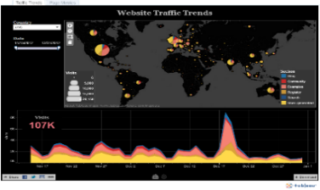
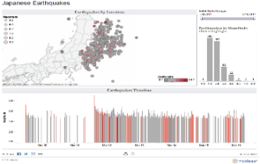
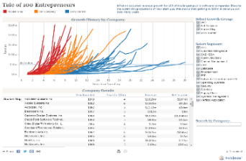
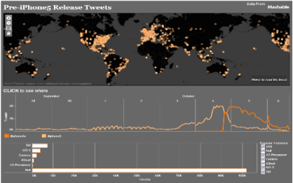
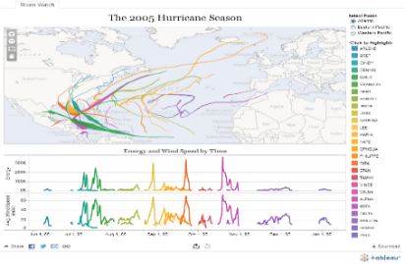
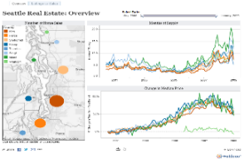
What question are you trying to answer?
Notes:
We are going to do 1 more quick exercise. Everyone was asked to bring a dashboard that is either complete or close to complete. Take your pen and paper and write down the question(s) your dashboard is trying to answer.
We maybe referring back to these questions throughout the workshop and challenging you if your content is answering your intended questions or new questions.
This is really important…many times we throw the kitchen sink and try to solve 100 problems in one dashboard. We need to take a minute and reflect on the problem we are trying to solve.

Slide 7
Chart Type
Notes:
One of the biggest challenges people face – how do I display my data in a meaningful way that isn’t just a crosstab. In this section we will review some common but not all chart types and explore if they are conveying the correct message.

Slide 8
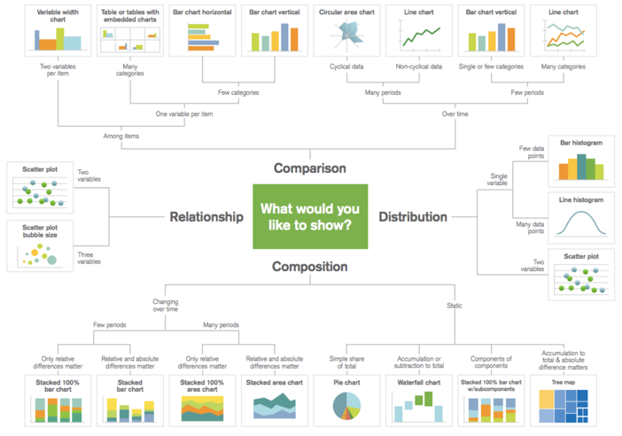
Do I have the right chart?
Notes:
A common mistake that I hear many people make is that they choose the chart type that they want. For example, declaring that they want a bar chart or a line graph vs spending time exploring their data, understanding the story they want to tell, and choosing a chart type that supports their analysis.
Take a look at the charts on your dashboard.. What are you trying to do?
Comparison – are you comparing one or more variable?
Relationship – are you showing a connection or correlation between two or more variables?
Composition – are you showing a change over time and/or parts to a whole?
Distribution – are you attempting to identify outliers and trends?
We are going to take the next few minutes to review some common chart types and explore if they are trying to answer the intended question.
Additional resources:
https://public.tableau.com/profile/josh.weyburne#!/vizhome/CookBook/VizCookbook
https://public.tableau.com/en-us/gallery/visual-vocabulary
https://public.tableau.com/views/TheTableauChartCatalog/TableauChartExamples?:embed=y&:display_count=yes&:origin=viz_share_link&:showVizHome=no#1
https://public.tableau.com/profile/bbc.audiences#!/vizhome/BBCAudiencesTableauStyleGuide/MoreInfo2
Call to action: ensure every participant has their own Tableau Public site and is subscribed to the viz of the day as we review the above resources. Invite people to follow along and bookmark these links.

Slide 9
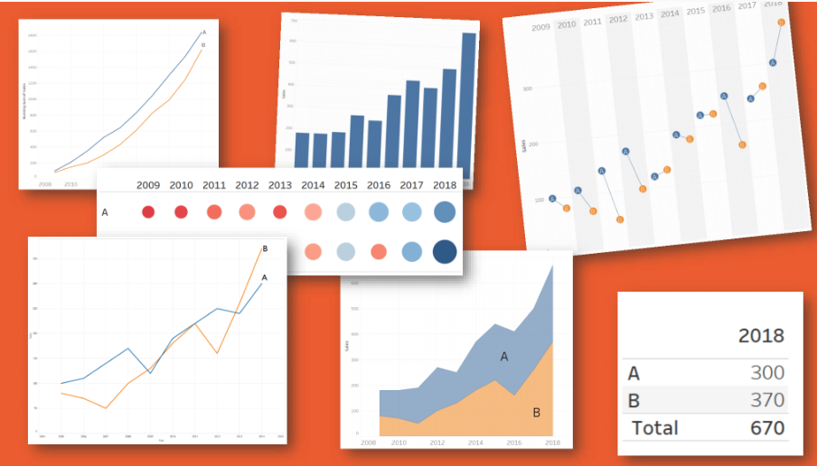
Choosing a Chart Type
Notes:
There are five primary types of visual mappings that content creators and consumers should understand:
Comparison, represented as a bar
Spatial, represented as a map
Temporal, represented as a line
Compare two measures, represented as a scatterplot
Precise number, represented as a text table
Line — Viewing trends in data over time. Examples: Stock price change over a five-year period, website page views during a month, revenue growth by quarter.
Bar — Comparing data across categories. Examples: Volume of shirts in different sizes, website traffic by origination site, percent of spending by department.
Heat Map — Showing the relationship between two factors. Examples: Segmentation analysis of target market, product adoption across regions, sales leads by individual rep.
Highlight Table — Providing detailed information on heat maps. Examples: The percent of a market for different segments, sales numbers in a particular region, population of cities in different years.
Treemap — Showing hierarchical data as a proportion of a whole. Examples: Storage usage across computer machines, managing the number and priority of technical support cases, comparing fiscal budgets between years.
Gantt — Showing duration over time. Examples: Project timeline, duration of a machine’s use, availability of players on a team.
Bullet — Evaluating performance of a metric against a goal. Examples: Sales quota assessment, actual spending vs. budget, performance spectrum (great/good/poor).
Scatterplot — Investigating the relationship between different variables. Examples: Male versus female likelihood of having lung cancer at different ages, technology early adopters’ and laggards’ purchase patterns of smart phones, shipping costs of different product categories to different regions.
Histogram — Understanding the distribution of your data. Examples: Number of customers by company size, student performance on an exam, frequency of a product defect.
Symbol maps — Use for totals rather than rates. Be careful, as small differences will be hard to see. Examples: Number of customers in different geographies.
Area maps — Use for rates rather than totals. Use sensible base geography. Examples: Rates of internet-usage in certain geographies, house prices in different neighborhoods.
Box-and-Whisker — Showing the distribution of a set of a data. Examples: Understanding your data at a glance, seeing how data is skewed towards one end, identifying outliers in your data.

Slide 10
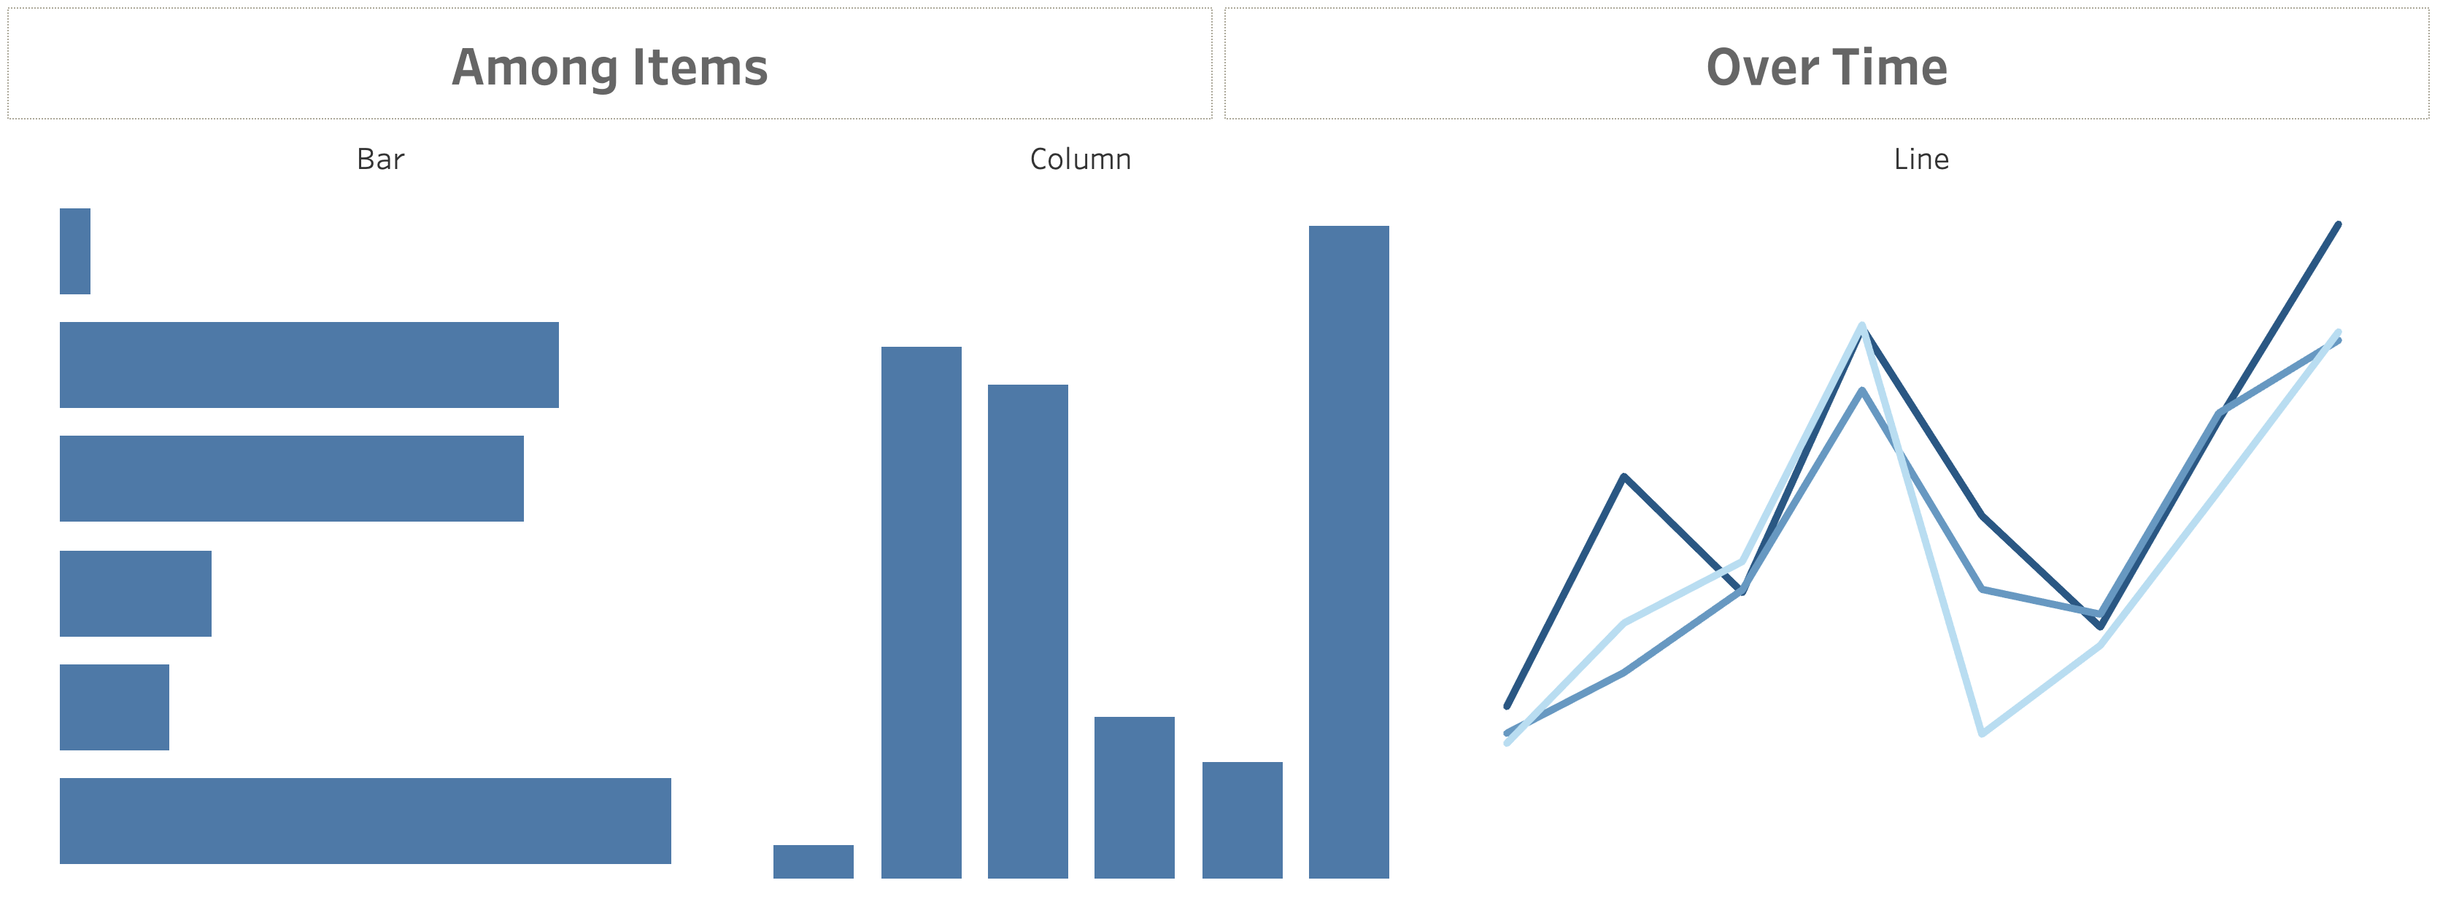
Comparison
Notes:
Comparison charts are designed to set one variable apart from another
These charts also display how the two variables interact with each other.
They can compare items or one another or show differences over time.

Slide 11
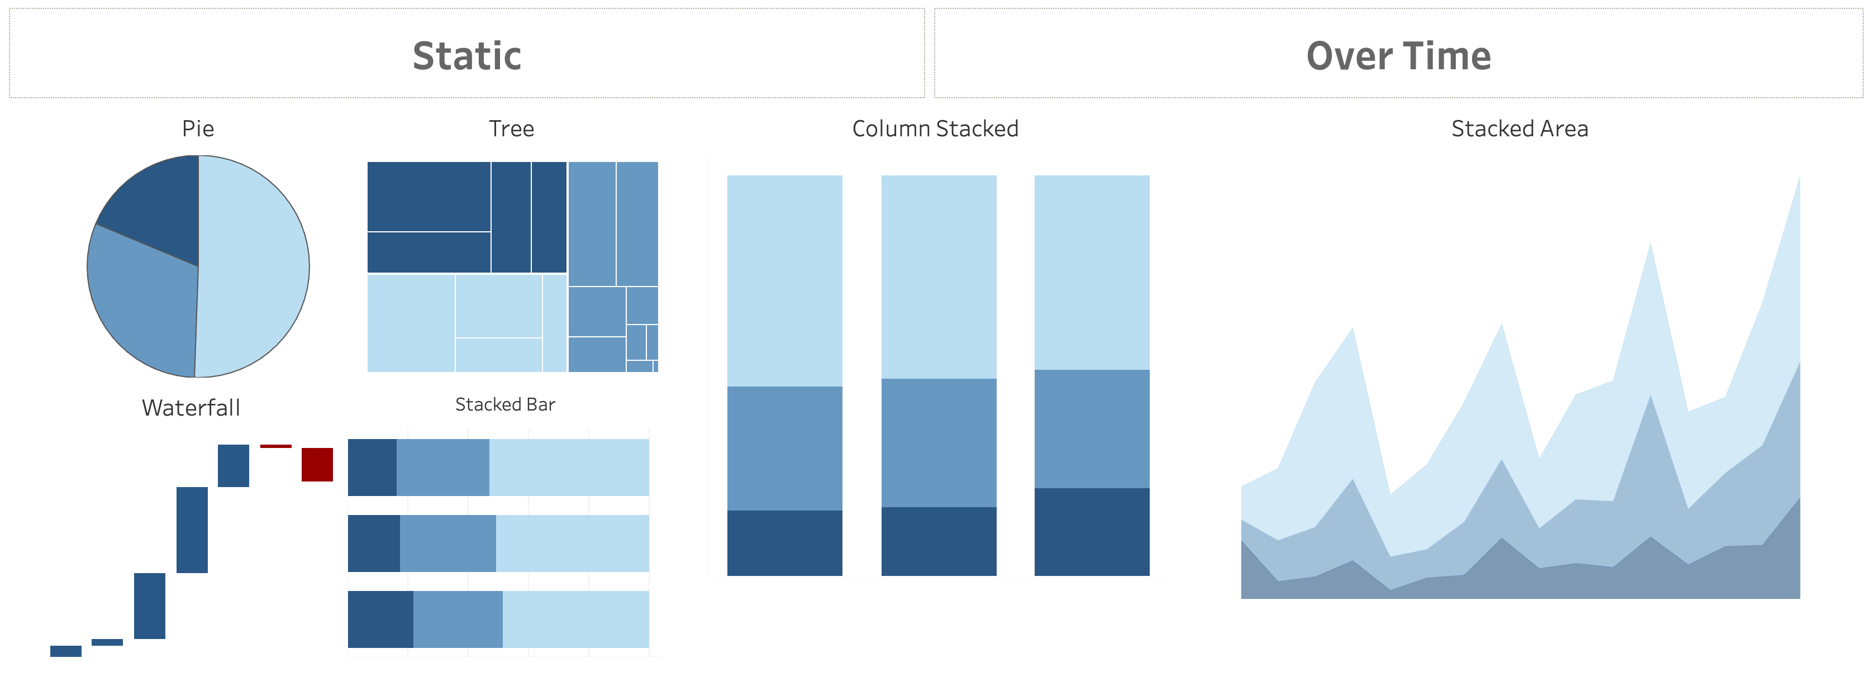
Composition
Notes:
Composition charts are used to display parts of a whole and change over time.
Pie charts callout: friends don’t let friends use pie charts (or 3D charts)… but if you must, use when comparing no more than 3 variables at a time.
Audience participation opportunity: why don’t we love pie or 3D charts when performing visual analysis?
Answer: We are not as good at noticing area and angle, and those just so happen to be the two main aspects of a pie chart. (swag opportunity for participant)
https://interworks.com/blog/rcurtis/2018/01/19/friends-dont-let-friends-make-pie-charts/

Slide 12
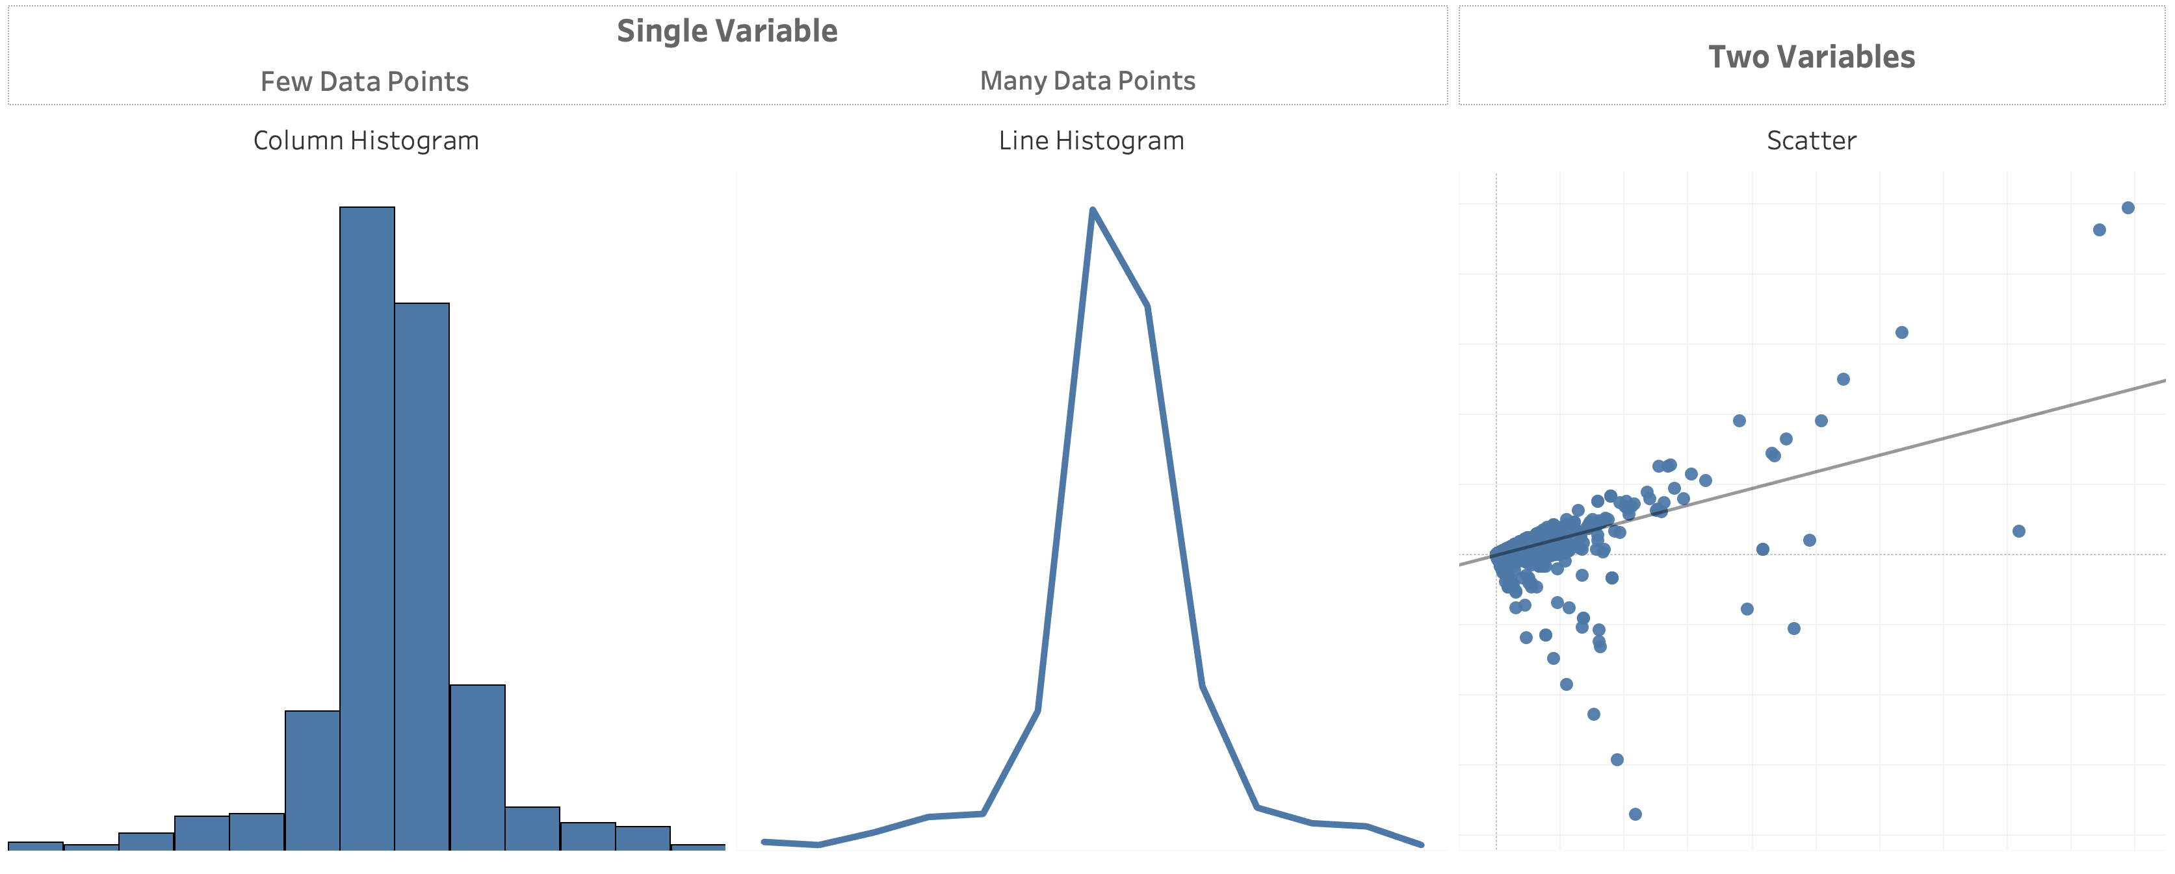
Distribution
Notes:
Distribution charts are used to show how variables are distributed over time, helping identify outliers and trends.

Slide 13
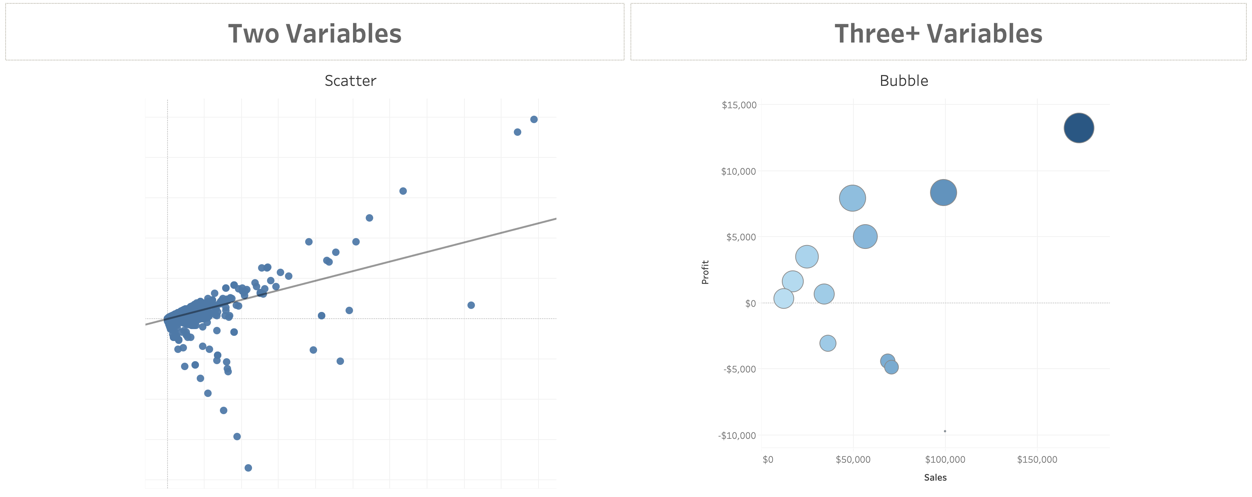
Relationship
Notes:
Relationship charts are used to show a connection or correlation between two or more variables.
When thinking about the right chart type for the question your dashboard is trying to answer, consider these additional resources:
Additional resources from Public:
Tableau Cookbook – navigate to a line chart, ask if anyone knows who the creator named is? (swag opportunity for participant)
BBC Style Guide
100 chart types
Call to action: ensure every participant has their own Tableau Public site and is subscribed to the viz of the day

Slide 14
Dashboard Flow

Slide 15
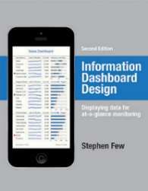
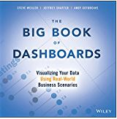
What is a dashboard?
“A dashboard is a visual display of data used to monitor conditions and/or facilitate understanding”
“A dashboard is a visual display of the most important information needed to achieve one or more objectives; consolidated and arranged on a single screen so the information can be monitored at a glance.”
Big Book of Dashboards (2017)
Stephen Few (2004)
Notes:
Plenty of definitions. Here’s one from Stephen Few. And if you haven’t read his Info Dash Design book – you must!
Right info to the right audience in the right medium so they can digest the information in the shortest time possible.

Slide 16
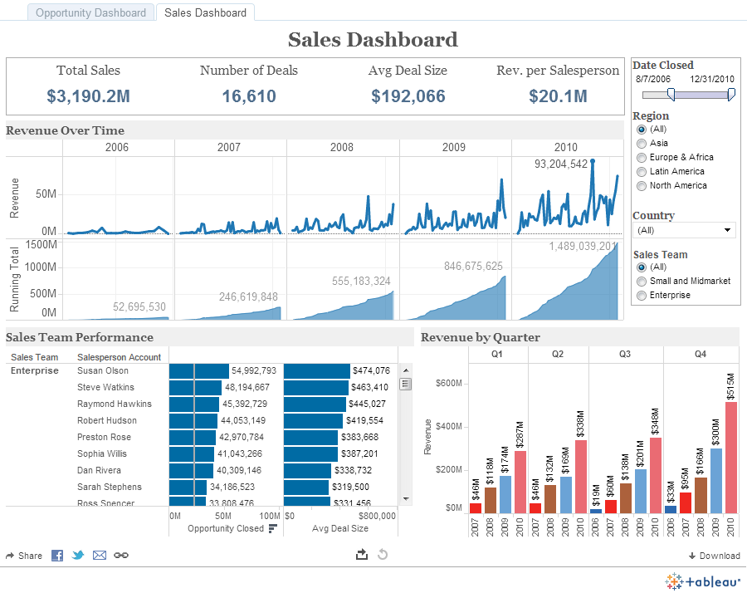
EXPLORATORY
NEUTRAL
Notes:
Exploratory:
Good exploratory visualizations explain what is going on.
Just the facts. Allows the end user to complete their own analysis based on the data.

Slide 17
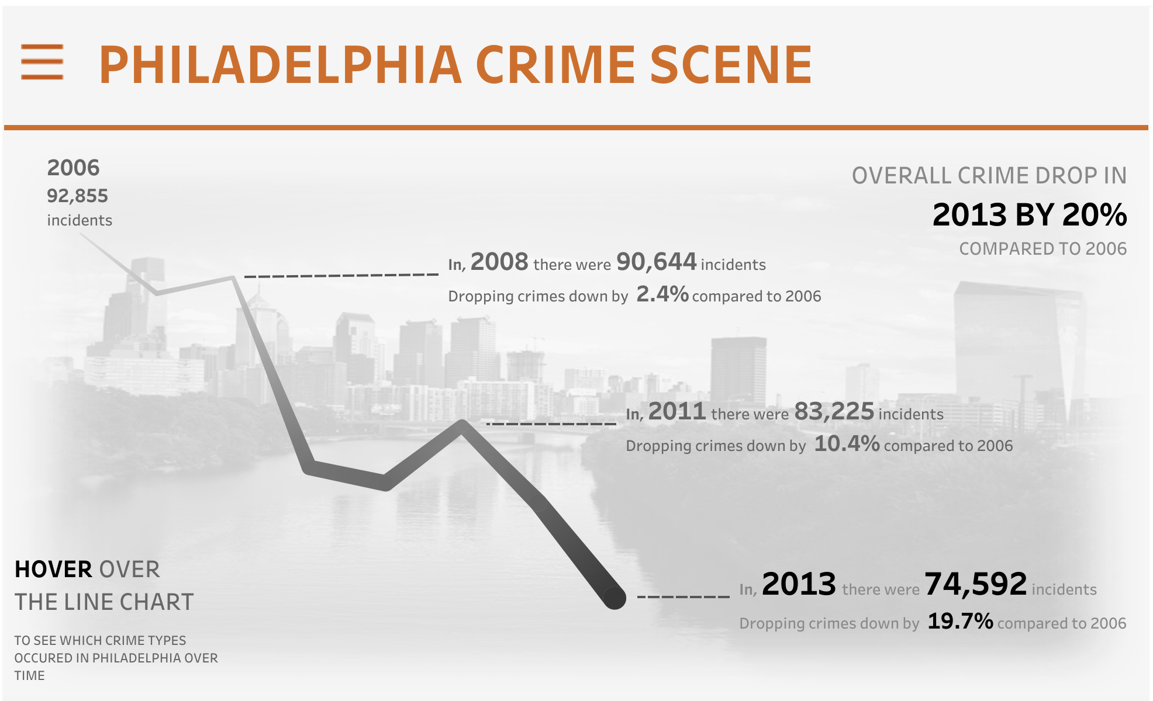
EXPLAnatory
OPINIONATED
Poojah Gandhi
https://public.tableau.com/profile/poojagandhi#!/vizhome/IronViz-PhiladelphiaCrimeScene/PhiladelphiaCrimeScene
Notes:
Explanatory:
- Answers Direct Questions
- Delivers Information
- Often Static
good explanatory visualizations let people explore the ideas.
In this example: Poojah Gandhi emphasizes specific data points in the dataset to tell a bigger story about Philadelphia’s Crime Scene.
This viz captures key facts accompanied by text to bring the reader along in the data journey to explain how and why we’ve arrived a certain end result.

Slide 18
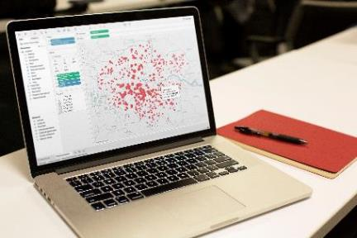
What makes a good dashboard?
Answers a set of questions
Follows a flow and invites interactivity
Condensed; primarily in the form of summaries and exceptions
Specific to and customized for the dashboard’s audience and objectives
Provides appropriate text for clarity and direction, if needed
Makes strategic use of color
Notes:
When it comes to visual best practices, there aren’t any hard and fast rules, such as “do this and never do that.” It isn’t a black and white process. There are, however, guidelines that make sense most of the time. Many of these derive from studies done on how we as humans process things like color, shape, and size. When you really understand the concepts driving these guidelines, only then should you break them.

Slide 19
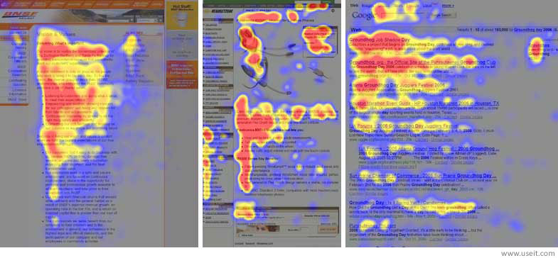
Layout
Notes:
How do people read web pages? They’re really interested in the top left.
Then they drift across to the right a fair way.
Then they figure they’ll go back and down a bit.
But then they get bored and drift all over the place.
Therefore – the most important thing should be in the top left: the headline, the instructions, the most important chart.
The logo should be in the bottom right!
Additional resources:
https://www.tableau.com/about/blog/2017/6/eye-tracking-study-5-key-learnings-data-designers-everywhere-72395
https://www.tableau.com/learn/webinars/eye-tracking-what-it-teaches-us-about-dashboard-design

Slide 20
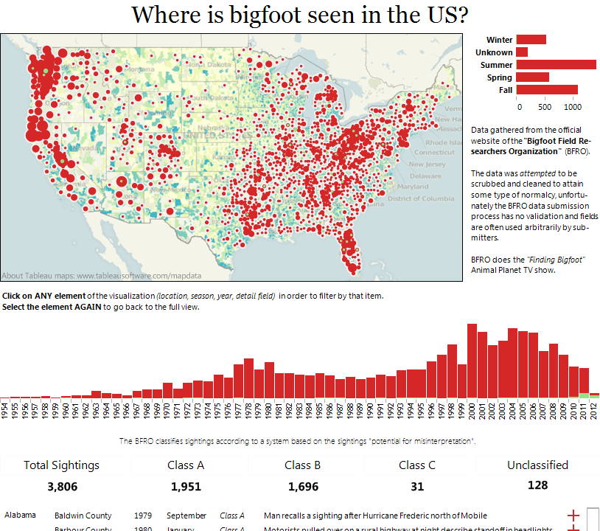
Layout Top Left:
Notes:
Let’s have a quick look on how the top left (and title) control the message
The message is the geographical distribution. What if we want the trend over time to be the message? How would we change the title and the graphics?

Slide 21
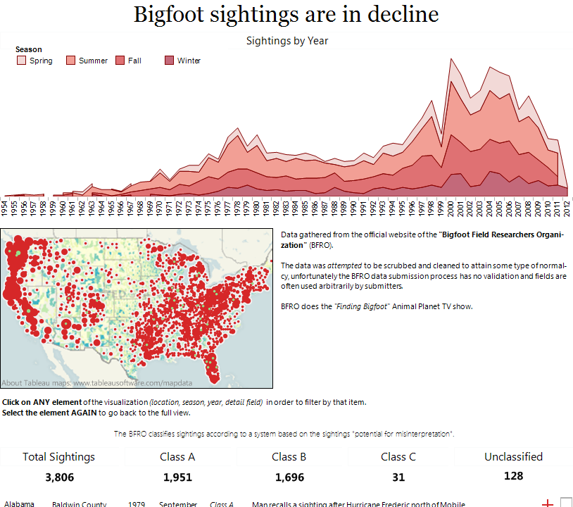
Notes:
Now we have a totally different message with exactly the same data – I’ve moved the time series to the top, and included the season data too. With this and the title, the dashboard’s message is completely different.

Slide 22
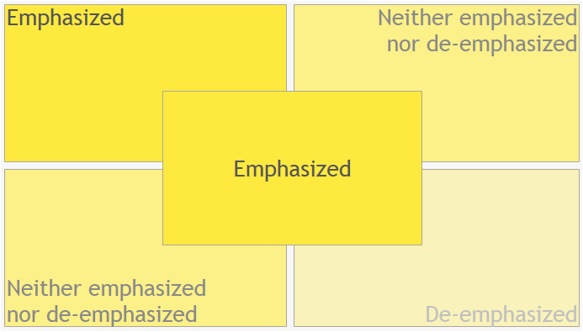
What are you emphasizing?
Notes:
Are you emphasizing something in particular? Do you have it where it will catch someone’s eye?

Slide 23
Inverted Pyramid
Most Newsworthy Info
Who? What? When? Where? Why? How?
Important Details
Other General Info
Notes:
This is a metaphor used by journalist to illustrate how information should be prioritized and structured in text. The widest part at the top represents the most substantial, interesting, and important information that the writer means to convey, illustrating that this kind of material should head the article, while the tapering lower portion illustrates that other material should follow in order of diminishing importance.
This metaphor holds true for a dashboard – the most important, newsworthy information should be at the top and the importance of information should filter down.

Slide 24
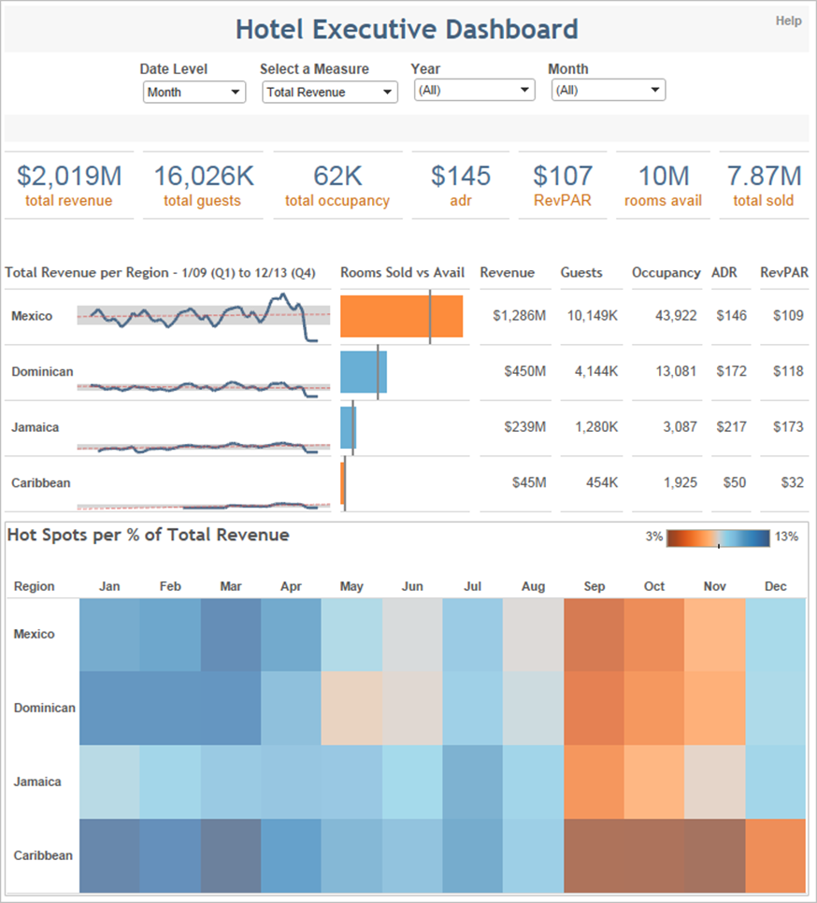
Filters at the top, so user knows when and how to start interacting
Most important information at the top and centered
Starts with the highest level and works down to more precise details
No more than 4-5 worksheets
Notes:
Let’s analyze the flow of this dashboard

Slide 25
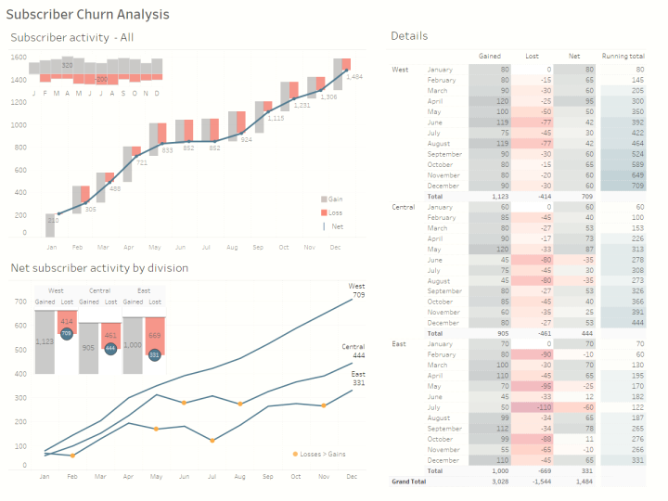
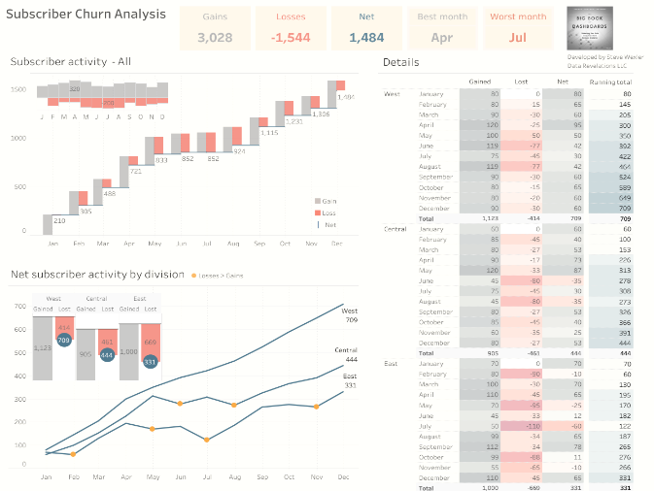
Using BANs
Notes:
These are large numbers. Typically, key performance indicators are anchor points for users to explore your dashboard – they practically scream “start here!” They can serve as conversation-starters, -finishers, and provide context to adjacent charts. They can even serve as universal color legends.
From Tableau’s 2016 eye tracking study:
(BIG) Numbers matter: One of the most striking patterns we saw was the visual attention paid to very large font numbers. Dashboards with very large numbers showed concentration of visual attention directly on the big number. Additionally, this attention happened very early in the viewing sequence, i.e. the first time you viewed something. So, if you have an important number, make it big!

Slide 26
Does your dashboard pass the 5 second test?
Most important view is on top or top left
Legends are near their views
Avoid multiple color schemes
Uses 5 or fewer views (charts)

Slide 27
Chart Type & Dashboard Flow Hands-on
Notes:
Duplicate your dashboard so you don’t overwrite what you started with so you will be able to show before and after.
(right click the dashboard tab, select duplicate, and rename to differentiate)
Think about what you just learned (is the chart type you have right for the job?)
*Set timer for 25 mins*

Slide 28
What dashboard changes did you make?
Did anyone change a chart type?
Notes:
Are there 5 volunteers that are willing to come up and show the before and after of their dashboard?
What are you thinking about for your next steps to improve your current dashboard or future dashboards?

Slide 29
Pre-Attentive Processing
Notes:
As a designers in the reporting space, it is our responsibility to develop dashboards that are easy to understand. By understanding basic pre-attentive attributes and applying them to our workbook designs, we are able to control what our audience sees and how quickly they digest the information.
Before I get into some of the specifics of these attributes, let me show you a quick example of what I mean…

Slide 30
Notes:
In this exercise we are going to take 3 seconds to try and identify which month has the highest number of sales for the year….
Are we ready?
Make it easier… Click

Slide 32
Notes:
Who can tell me which month had the highest number of sales?

Slide 33
Notes:
We are going to do this again but this time I want you to not just find one but the Top three performing months.
Are we ready?

Slide 34
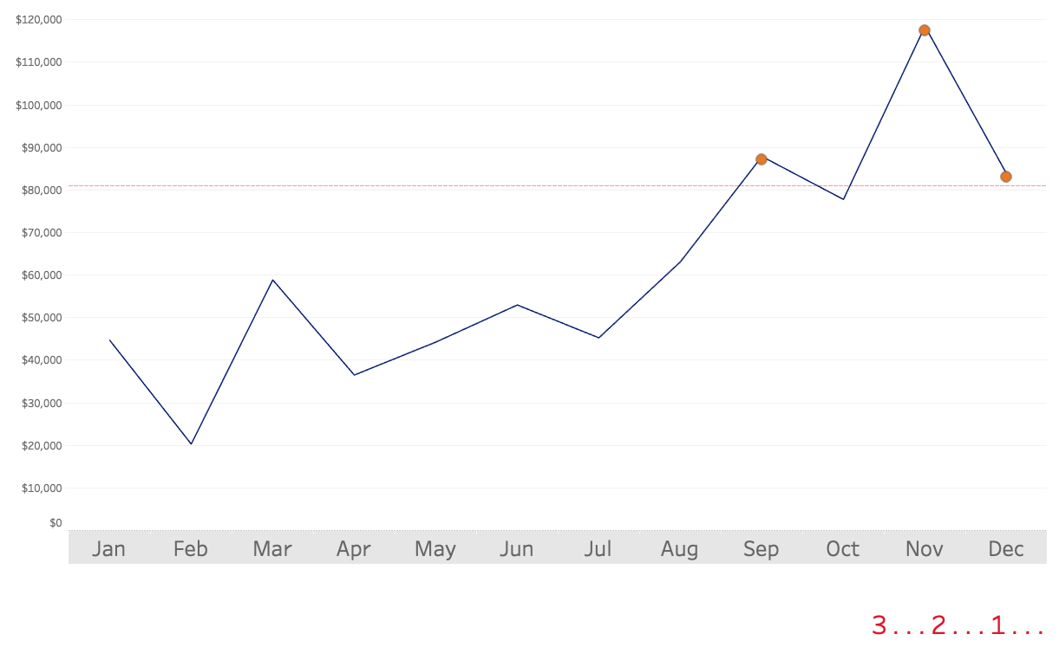
Notes:
Make it easier… Click

Slide 35
Notes:
How many of you were able to identify the top 3 performing months?

Slide 36
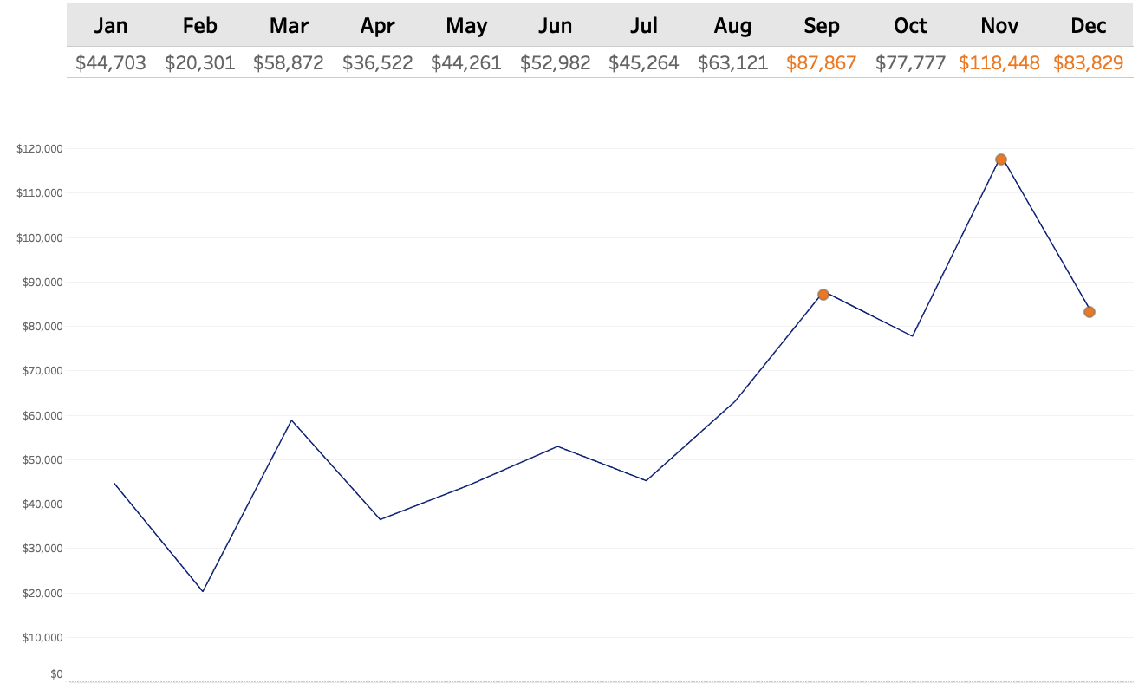
Notes:
So by visualizing the data and incorporating a few key pre-attentive attributes (like shape and color) I was able to effectively draw your eyes to the key places on the page where I wanted you to look.
Not only were you able to quickly identify data points of importance, you were also able to draw many other conclusions like: sales are steadily climbing, last 1/2 of the year out performed the first half.
The reason why we visualize data is so we can communicate information faster and make is easier to understand.

Slide 37
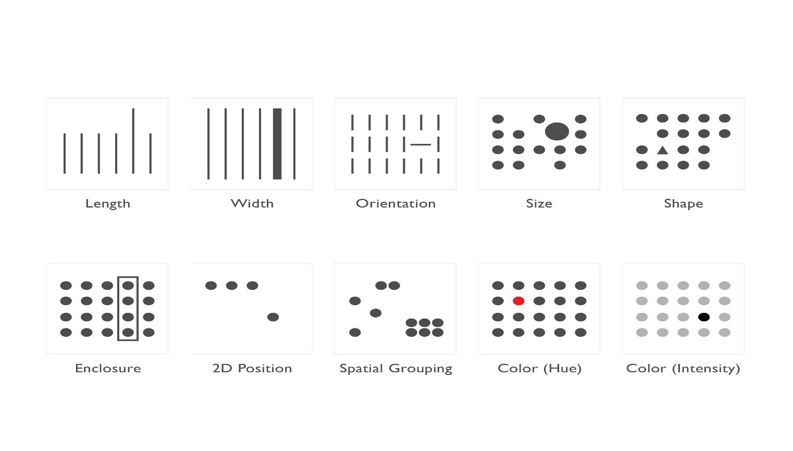
Length | Width | Orientation | Size | Shape
Enclosure | 2D Position | Grouping | Color (Hue) | Color (Intensity)
Notes:
Using pre-attentive principles in your dashboards allow your end user to process information faster and draw clear distinctions in the data. It gives you the ability to say more with less.
So whether you choose to draw these lines of distinction by using size, shape, width, or color; your end user will be able to better understand the message being delivered
Be mindful when using these principles as the brain is able to distinguish the differences in some better than others.
Let me show you what I mean…

Slide 38
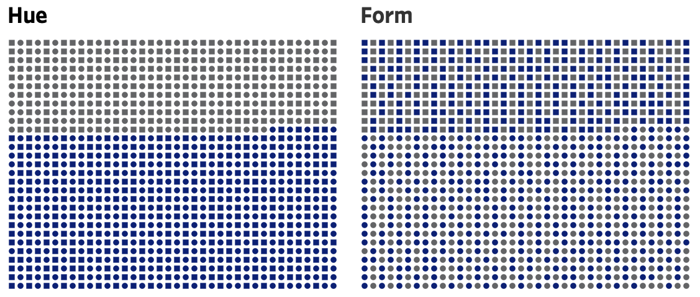
Notes:
In this example we have two images that consist of the same two shapes and two colors but are organized using different pre-attentive attributes.
Here you can see that color is easier to distinguish than shape.
Let’s look at another one…

Slide 39
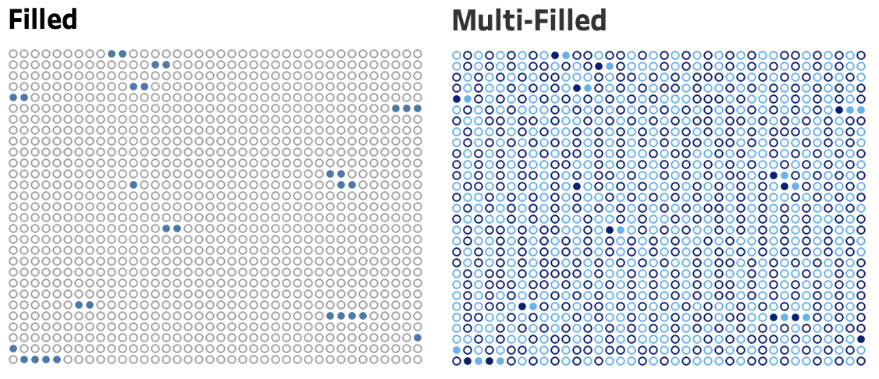
Notes:
Be cautious not to try to incorporate too many attributes in your viz. We don’t want to overstimulate our end users with too much information… the message can get lost in translation.
Less is best.

Slide 40
COLOR
Notes:
The Color wheel helps you understand how colors relate or don’t relate to each other.
Colors next to each other share similar values, and colors opposite from each other don’t. When you’re choosing your hues, which I’ll talk about next, this is what you want to be referencing.
Complementary colors are any two colors which are directly opposite each other, such as red and green and red-purple and yellow-green.
Choose Complimentary colors for contrast
Analogous Colors for flow and association
Triadic colors for balance.

Slide 41
Hue
Saturation
Tone
Shade
Tint
Notes:
Color is comprised of three components: hue, saturation, and brightness.
Hue is what you find on the color wheel – it’s what we think of when we hear the word ”color”. It’s the red, it’s the green, it’s the turquoise.
Saturation There are three ways you can saturate the color of your chosen Hue. You can add grey and change its Tone, Black and change its shade, or White and change its tint.
However you choose to change the intensity of your color is up to you. Any of the 3 are acceptable, all just comes down to the design of your dashboard.
Let’s talk about how you may use Hue within and dashboard and when you may choose to saturate…

Slide 42
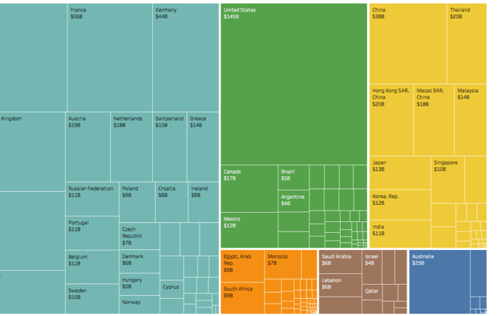
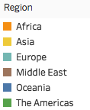
Using Hue
Qualitative / Categorical
Notes:
How do these components of color play into the translation of data?
When we have quantitative or numerical data, the changes are reflected by a change in tone (primarily saturation). On the left we have a single hue that gradually becomes less saturated, and on the right we have a divergent color scheme, so two hues, that gradually become less saturated as they work towards grey in the middle. It’s good to note that color is not a good visual encoder when trying to illustrate small quantitative differences; if you want to show small variate, consider using length or position for this.
When we have qualitative or categorical data, the differences are represented by changing the hue. This is when you would reference the color wheel to choose hues that are distinct from one another
Limit the number of hues to 7

Slide 43
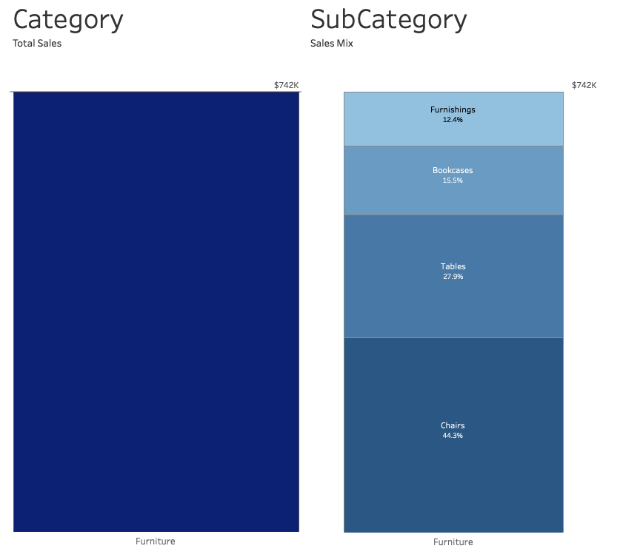
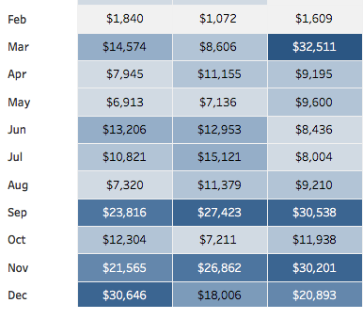
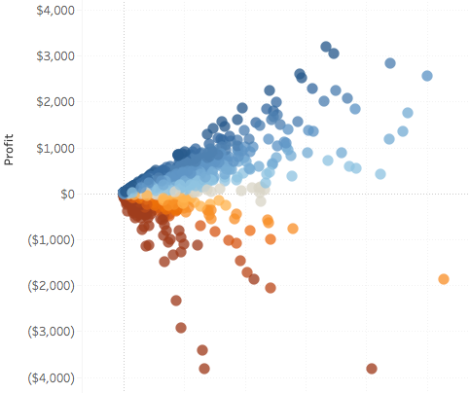
Using Saturation
Relationship /Sequence
Quantitative / Numerical
Notes:
Use color consistently, so we understand its meaning
Always use the same color to represent the same meaning or category throughout all of your vizzes.
Color is one of the quickest and easiest ways to visualize relationship throughout a dashboard.
Visually group items of association by assigning various saturation to attributes correlating to the parent hue.

Slide 44
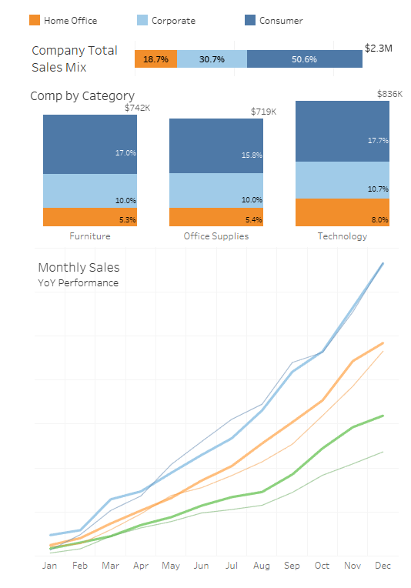
Maintain Color Identities
Once a color is assigned to an attribute, be consistent with the usage of that color.
This eliminates confusion and establishes identity throughout a workbook.
Notes:
Use color consistently, so we understand its meaning
Always use the same color to represent the same meaning or category throughout all of your vizzes.

Slide 45
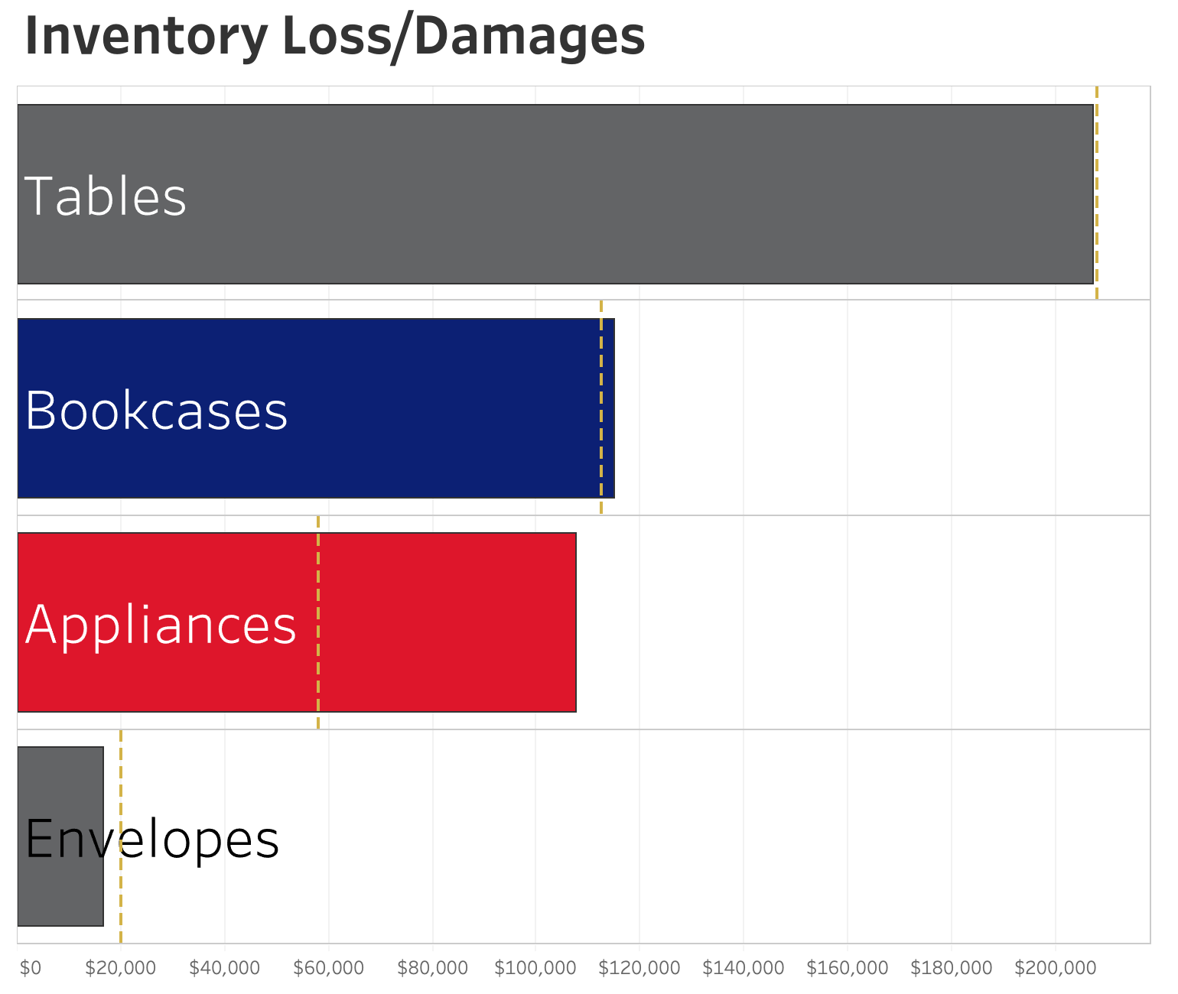
Use Hot Colors Sparingly
What are we supposed to be looking at?
'HOT' colors, like RED, are attention grabbers.
They carry heavy visual weight and will draw the eye of the reader.
Save them for elements truly deserving of your reader's attention.
Notes:
This is like walking into a cat fight.
Using too many colors causes them to compete for our attention
Apply color sparingly so we know where to pay attention

Slide 46
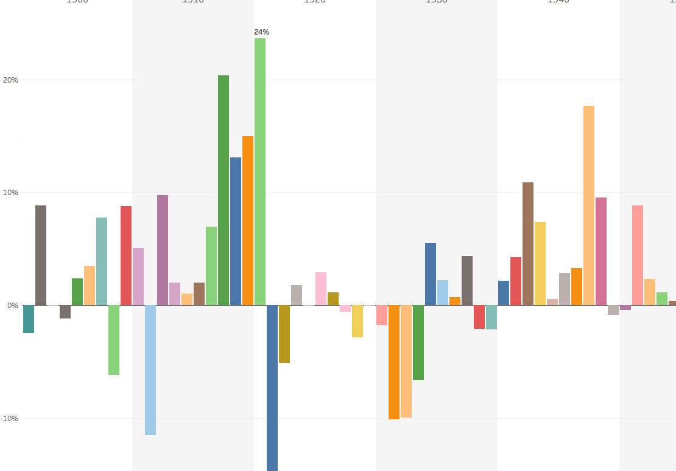
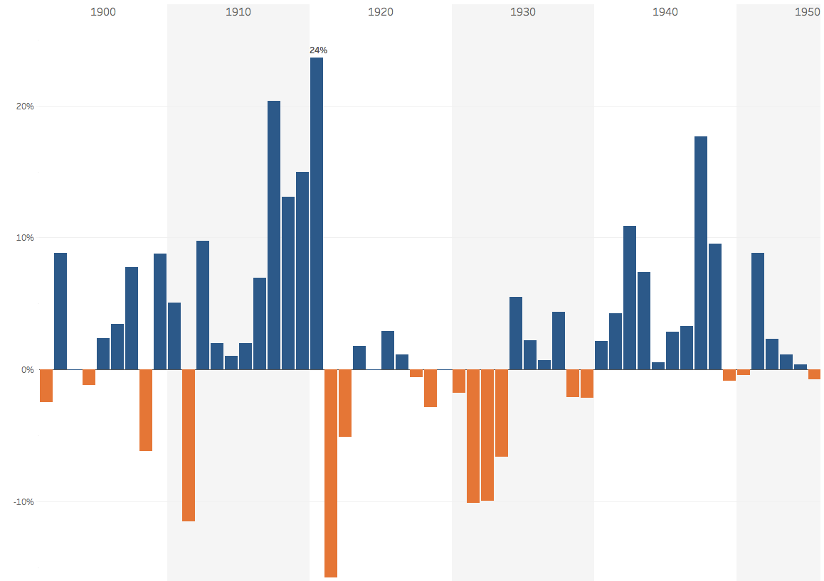
Be Careful Not To Become The Next
Vincent van Gogh
Notes:
Everyone loves colorful art… just not in a report.
Color should be used to highlight key data indicators and allow easier definition of the overall data story.

Slide 47
DONT BE AFRAID...
WHITE SPACE
Notes:
Sometimes we see empty space on our dashboard canvas and become overcome with this insatiable need to fill it. DON’T GIVE IN!
Allow your dashboard to breath…
White space can provide balance to your dashboard and

Slide 48
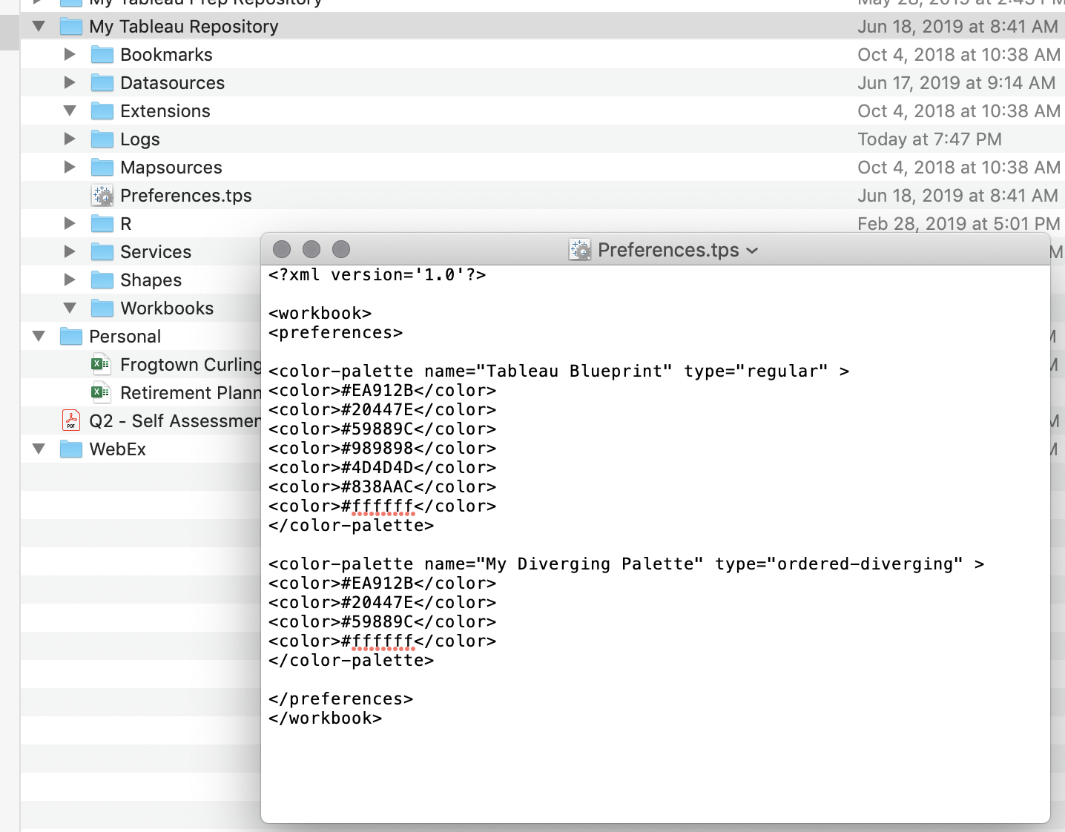
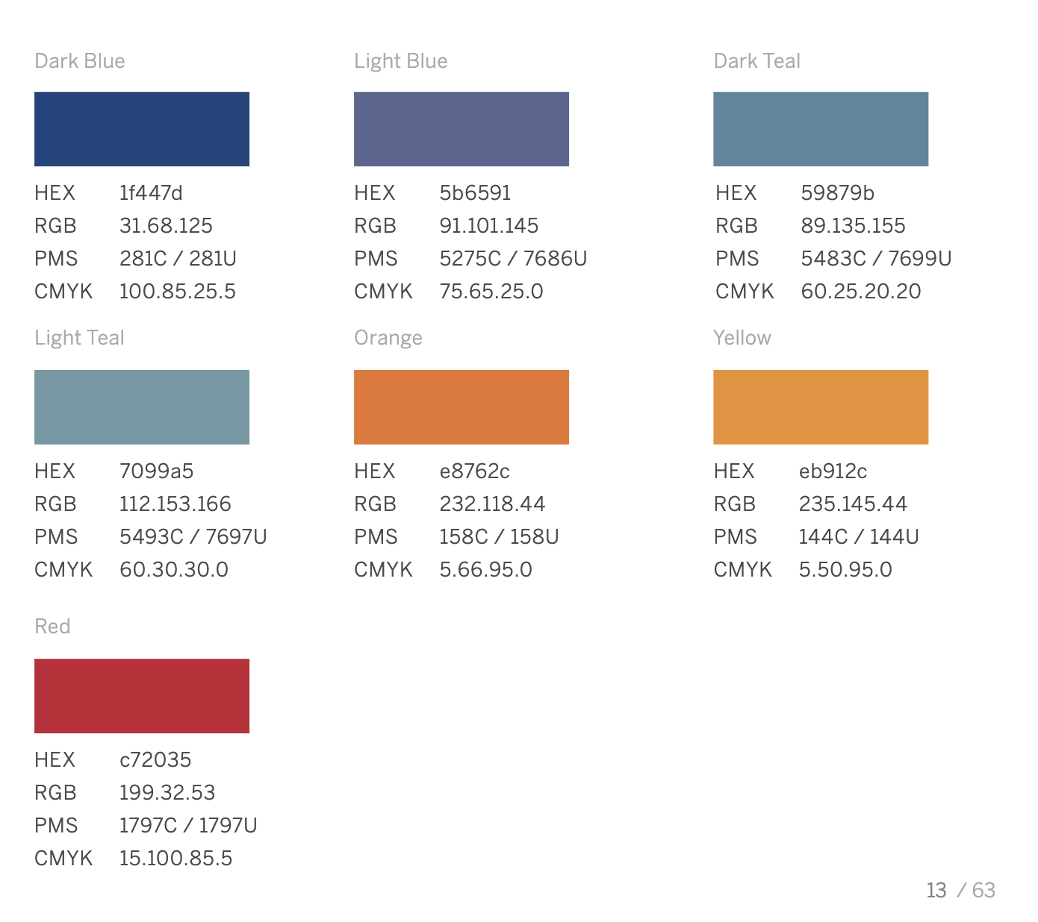
Style Guide - Custom Color Palette
Notes:
Locate your company’s Style Guide to learn more about your Brand Standards. There you will find your company’s branded color palette as well as direction on how to use those colors. There you will also find more information on images, logos, and icons.

Slide 49
Title

Slide 50
A concise, descriptive title can make a huge difference in garnering attention and making a chart more memorable
Notes:
Full Page Image w Color Bar

Slide 51
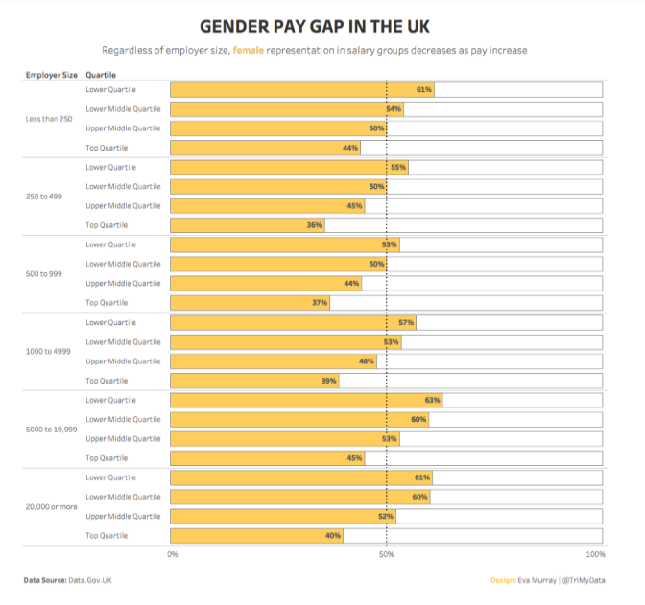
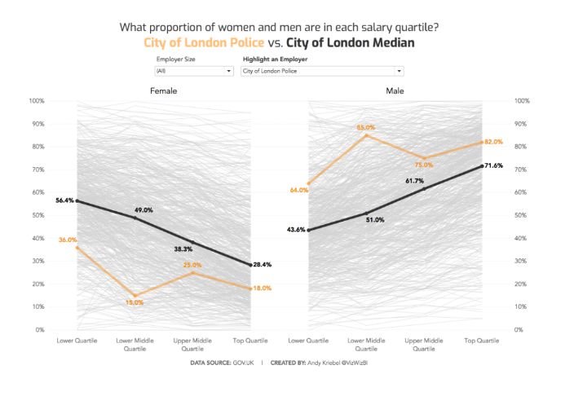
Which title is more impactful?
Notes:
Trick question – I would argue that both titles are impactful for the story they are telling. The first chart is explanatory – the text is clearly explaining the content and second is exploratory where the text is inviting you to explore different employers compared to the city of London

Slide 52
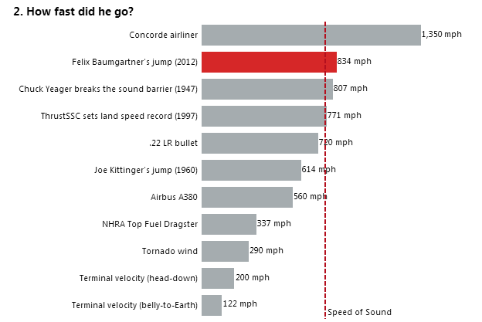
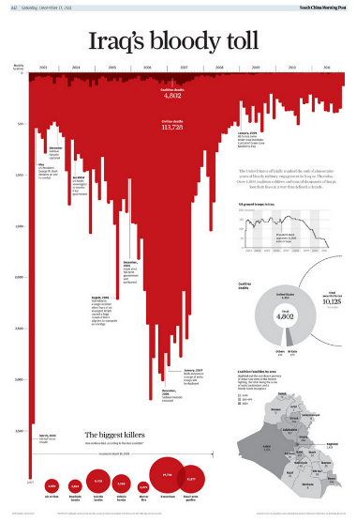
Do your titles capture attention?
Notes:
The title should get inside the users brain and spark interest. It can excite, scare, be controversial, drive curiosity, invoke emotion, educate or be intriguing.
Bigfoot sightings are in decline – not super attention grabbing but in the title supports the context below by showing the sightings over time
How fast did he go? – My attention is grabbed. The design of the dashboard draws me to the red bar (prior context this is Felix Baumgartner’s jump to Earth from a helium balloon). I can quickly rank and compare how fast he went vs other common dimensions. The reference line is a nice touch as it adds an additional element of comparison.
Iraq’s bloody toll –this dashboard was published in South China’s Morning Post by Simon Scar– the word choice in the title is matched by the attention capturing bar chart – yes this is just an inverted bar chart made to look like blood.

Slide 53
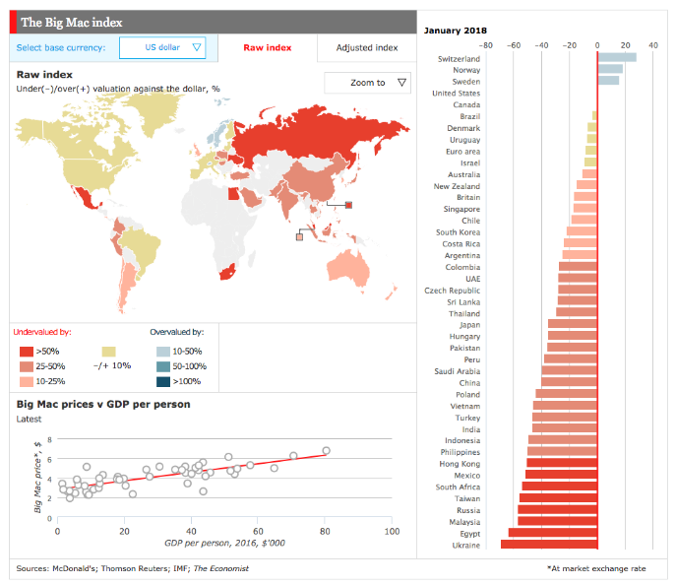
Context is not just in the title
Notes:
Think about everywhere you have text on your dashboard – are your charts and axis' labeled appropriately?
Do you just have number of records on your axis title? Is there clear and concise context you can add for the reader?

Slide 54
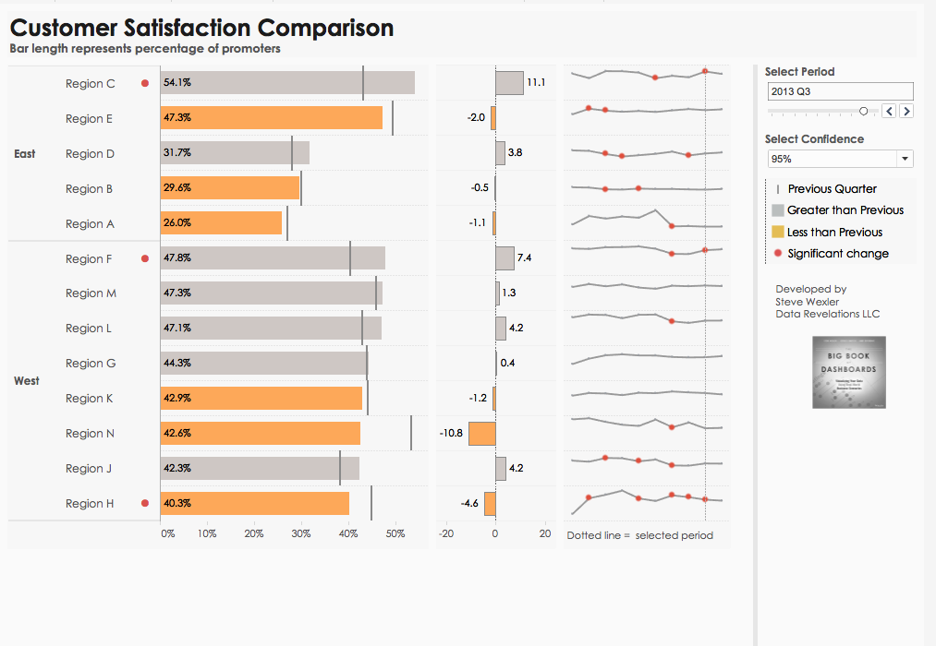
Adding additional context
Notes:
Sometimes it is too cluttered to label an axis, using subtitles is a perfect way to indicate what the axis is representing.

Slide 55
Tooltip

Slide 56
Tooltips can make the difference between a user loving your visualization and not understanding it.

Slide 57
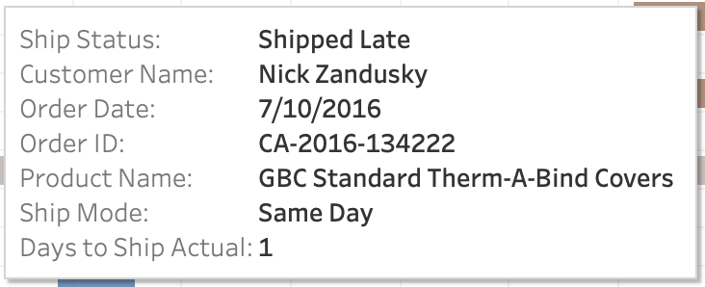
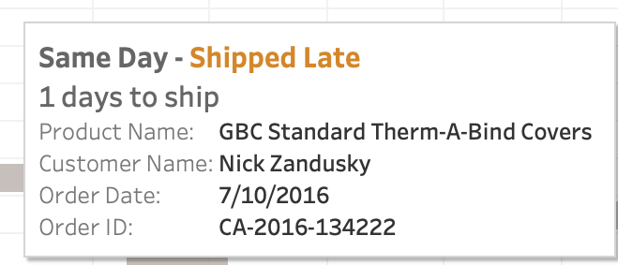
Tips for improving the basic tooltip
Use a proper font
Identify the most important part of the tool tip and make it your title
Change measure names/values to make them specific and understandable
Include proper units
Remove command prompts
Default
vs
Modified

Slide 58
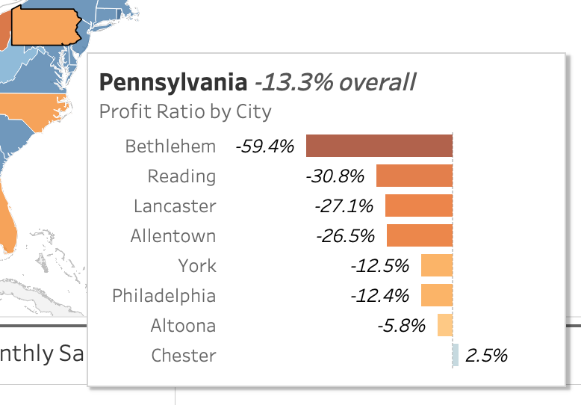
Viz in Tooltips
What are they good for?
Highlighting trends
Describing the distribution of data
Layering different levels of time or geography
String aggregations – getting rid of that *

Slide 59
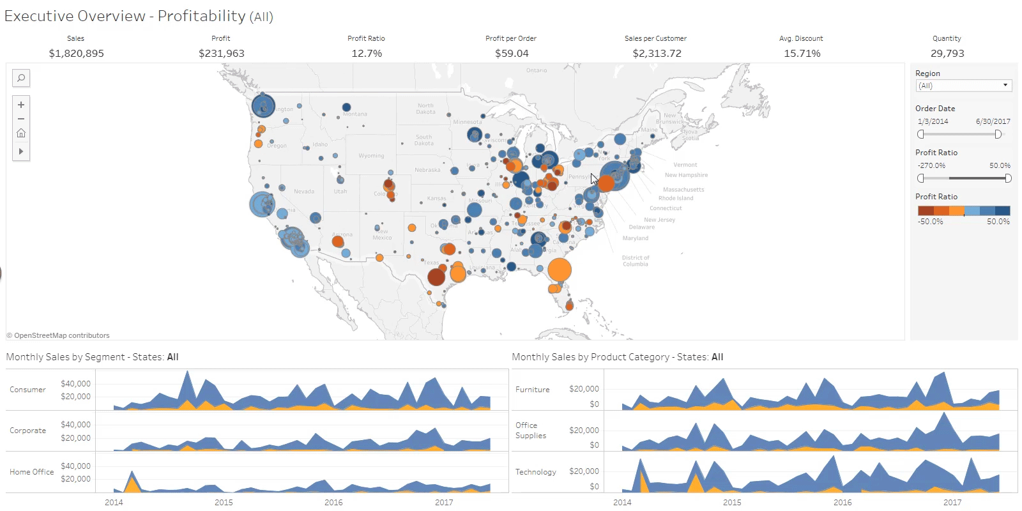
Notes:
(GIF will play animation when in presenter mode)

Slide 60
Pre-Attentive Attributes, Title, and Tooltips Hands On
Notes:
Think about what you just learned….
*set timer for 25 mins*

Slide 61
Share and Tell
Notes:
Are there 5 volunteers that are willing to come up and show the before and after of their dashboard?
What are you thinking about for your next steps to improve your current dashboard or future dashboards?

Slide 62
Next steps…

Slide 63
You learned a lot today. Want to keep learning?
Visual Best Practices (classroom training)
Learning Paths (eLearning)
Public Gallery (inspiration)
TC19 on-demand (virtual)
TC20 (October 5– 8th 2020)
Notes:
*As of 1/30/20 TC20 tickets are not yet on sale
https://www.tableau.com/learn/webinars/eye-tracking-what-it-teaches-us-about-dashboard-design
https://www.tableau.com/about/blog/2017/6/eye-tracking-study-5-key-learnings-data-designers-everywhere-72395

Slide 64
Want to read more about visualization?
The Big Book of Dashboards
Visual Reporting and Analysis: Seeing is Knowing Whitepaper
Visual Analysis Best Practices: A Guidebook Whitepaper
Data Storytelling: Using visualization to share the human impact of numbers Whitepaper
Beautiful Evidence – Edward Tufte
Information Dashboard Design – Stephen Few
Information Visualization – Colin Ware

Slide 65
One last thing that is guaranteed to make your dashboards amazing…

Slide 66
Notes:
Full Page Image w Color Bar

Slide 67
THANK YOU!
Notes:
Full Page Image w Color Bar

Slide 69
Notes:
Full Page Image w Color Bar

Slide 70
Notes:
Full Page Image w Color Bar

