Slide 1
Advanced Mapping Techniques
PRESENTED BY
Dan Cory
Jesse Gebhardt

Slide 2
What we are not covering…
Geography in Your Data
Tableau’s Geography
Symbol Maps and Filled Maps
Unmapped Locations
Map Navigation
Map Options
Map Data Feedback
(These topics are covered in the Mapping 101 session)

Slide 3
Agenda
Combo Maps
Background Images
Custom Geocoding
WMS – Web Mapping Service
Point to Point Maps
Distance Calculations

Slide 4
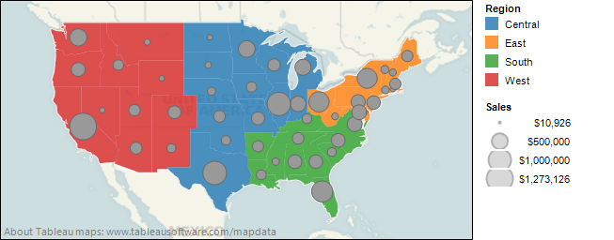
Combo Maps
7.0 Adds ability to do filled maps
Why not use them in combo charts (just like bars & lines)?
Filled maps work with other chart types

Slide 5
Agenda
Combo Maps
Background Images
Custom Geocoding
WMS – Web Mapping Service
Point to Point Maps
Distance Calculations

Slide 6
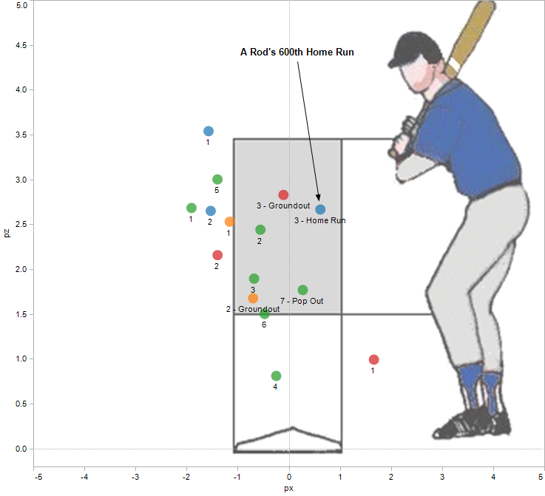
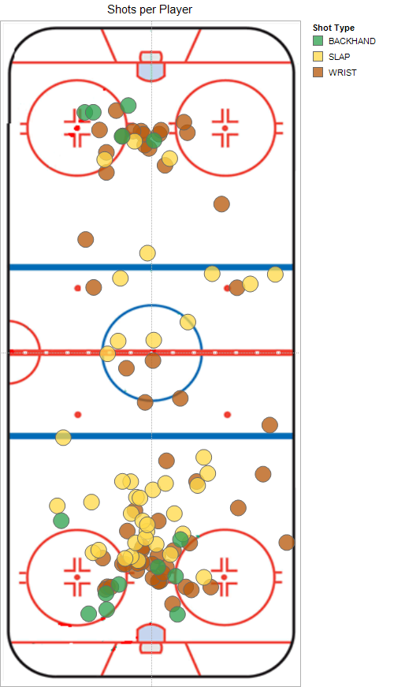
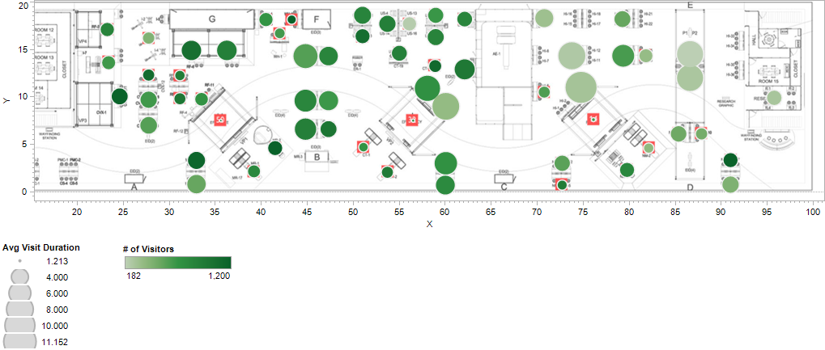
Background Images

Slide 7
Agenda
Combo Maps
Background Images
Custom Geocoding
WMS – Web Mapping Service
Point to Point Maps
Distance Calculations

Slide 8
Custom Geocoding
What you can do
Add new geographic roles
Add new hierarchies
Add new locations to an existing level
What you cannot do
Put existing levels under your new levels
Add additional alternate names to existing levels
Add polygons for filled maps
Notes:
Cannot states within sales region
Cannot change names
Change locations

Slide 9
What You Need
(Read the documentation first)
CSV file:
Unique ID (no duplicates)
Optional: IDs of containing levels (a.k.a. foreign key)
Latitude
Longitude
Schema.ini file (optional)
IDs should be Text
Even numeric fields like zip code
Latitude and Longitude should be Double
See http://msdn.microsoft.com/en-us/library/ms709353(VS.85).aspx for details on Schema.ini
Notes:
Schema .ini is the metadata that defines the formatting and such for the csv file.

Slide 10
Custom Geocoding Best Practices
Clean the data
Remove blank or duplicate rows
Check the data types
Format for leading zeros if needed
Use Tableau to connect to it as a sanity check
Use Schema.ini to enforce types and column names
Store in a common directory
Use subfolders for different locations or roles
Keep your CSV files
Notes:
LAT/lon double ints
Custom geocoding is not additive – need to re-
import everyting. So keep a good directory structure
Order the fields with the most readable name first
---the first field will be your default. “set default location”

Slide 11
Agenda
Combo Maps
Background Images
Custom Geocoding
WMS – Web Mapping Service
Point to Point Maps
Distance Calculations

Slide 12
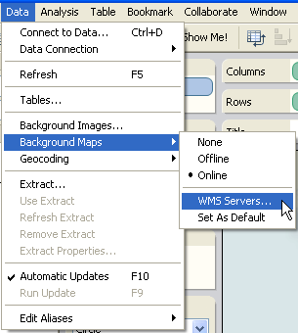
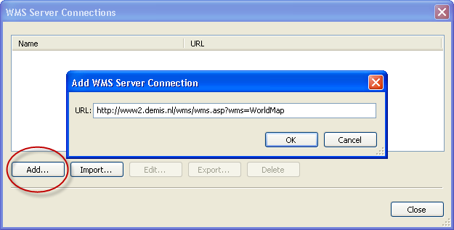
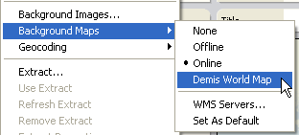
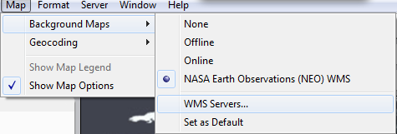
WMS Basics
(6.x)
(7.0)

Slide 13
Agenda
Combo Maps
Background Images
Custom Geocoding
WMS – Web Mapping Service
Point to Point Maps
Distance Calculations

Slide 14
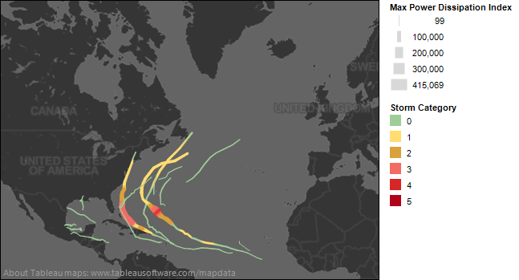
Point to Point Maps
Requires one row of data per vertex – IMPORTANT
Need a column that groups vertices into segments
Use size and color to indicate direction and/or amount

Slide 15
Agenda
Combo Maps
Background Images
Custom Geocoding
WMS – Web Mapping Service
Point to Point Maps
Distance Calculations

Slide 16
Distance Calculations
Two use cases
Find distances between all possible combinations of locations
Must have both locations on same row of data
Usually requires a self-join
Find distance to ‘benchmark’ or ‘lookup’ location
Can use Table Calcs and Parameters
No joining or data manipulation necessary
Many ways to calculate distance (Pythagoras, Haversine (Great Circle), Spherical Law of Cosines, etc.)
Haversine formula:
a = sin²(Δlat/2) + cos(lat₁)*cos(lat₂)*sin²(Δlong/2) c = 2*atan2(√a, √(1−a)) d = R*c where R is earth’s radius (mean radius = 6,371km)
Spherical law (does not account for elliptical shape of Earth):
d = acos(sin(lat₁)*sin(lat₂)+cos(lat₁)*cos(lat₂)*cos(long₂−long₁))*R

Slide 17
Summary
Combo Maps
Background Images
WMS
In house via ArcGIS and others; numerous public servers
Different layers than the Tableau built-in
Custom Geocoding
Add your locations, augment Tableau locations
Point to Point Maps
One row per vertex
Distance Calculations
Data requirements, different methods

Slide 18
Questions
Dan Cory: dcory@tableausoftware.com
Jesse Gebhardt: jgebhardt@tableausoftware.com

Slide 19
Please evaluate this session (TCC11 325) Advanced Mapping
Text to 32075
In the body of the message, type: TCC11<space>325
then letters from the table below to indicate each response.
Provide additional comments after an asterisk “*”
Sample text: TCC11 325aho*That was great!
Please give your response to the following: | Excellent | Great | Good | Average | Poor | Bad | Very Bad
What was the value of this session to you? | a | b | c | d | e | f | g
What are the chances you will apply what you learned in this session in your work? | h | i | j | k | l | m | n
What are the chances you would recommend this session to a colleague? | o | p | q | r | s | t | u
Each text evaluation you send enters you into a drawing for an iPad!
Notes:
19
Title
Month Year
19

