Slide 1
Tableau Day
Thursday October 17th, 2019

Slide 2
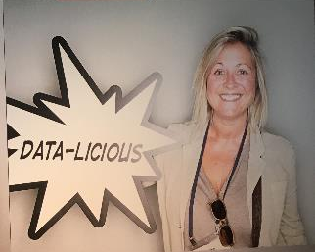
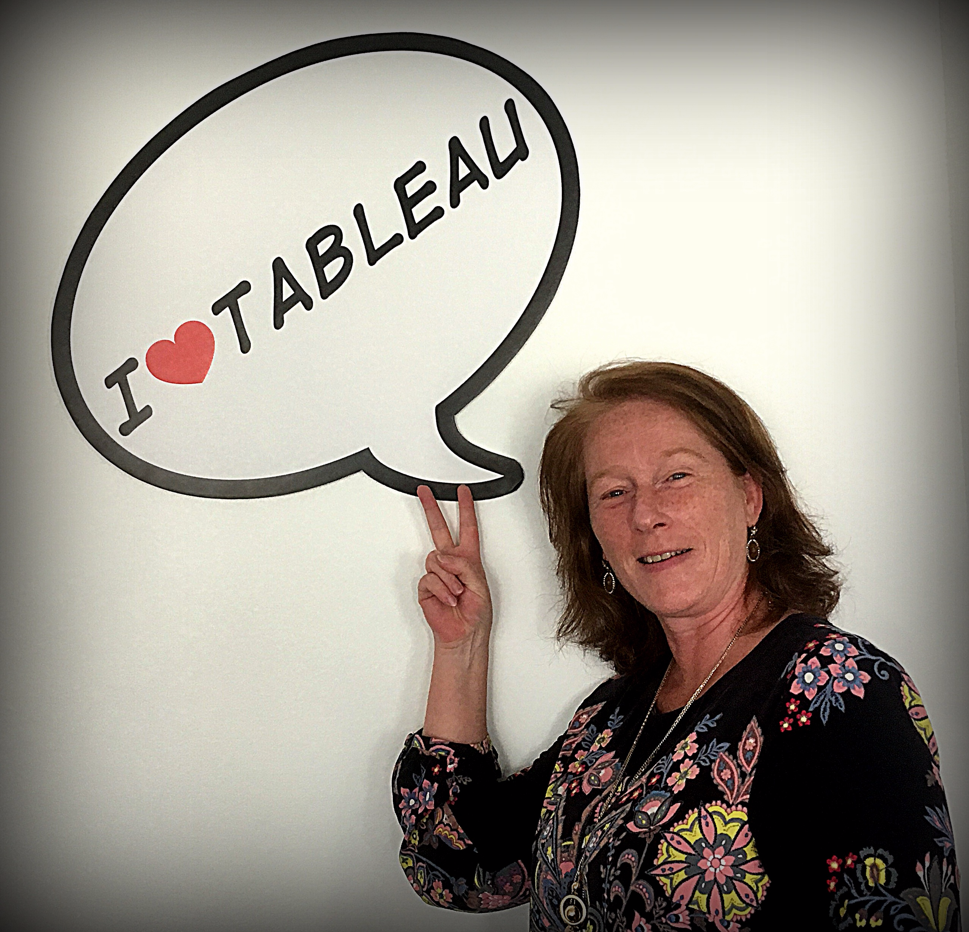
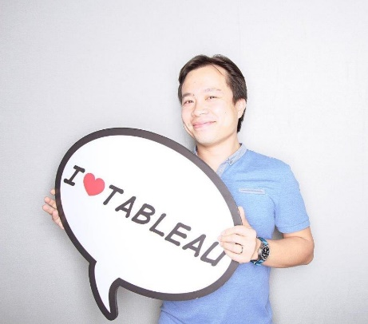
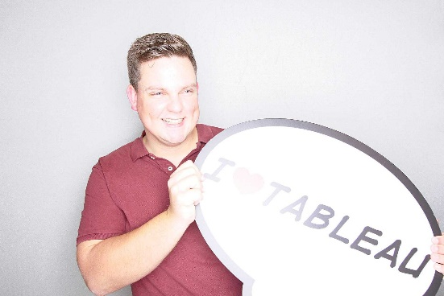
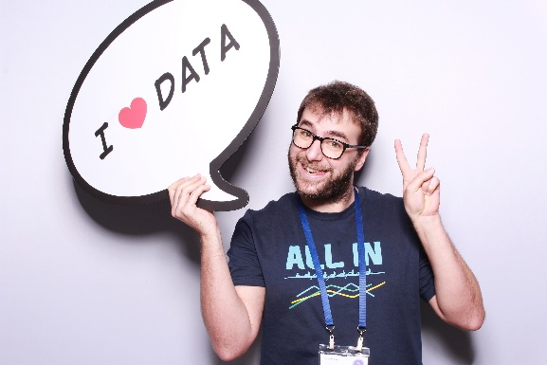
Tableau Team
Charlotte Filloux
Strategic Account Manager
Chrystelle Drouin
Sales Consultant
Roxane Wiart
Customer Success Manager
Benjamin Couve
Enterprise Sales
Alain Lok
Practice Manager
Bruno Verissimo
Solution Architect
Ruben Tip
Sales Consultant
Martin Moreau
Technical Account Manager

Slide 3
Agenda
09:30 – 10:00 - Updates on the Tableau Community at BNP Paribas
10:00 – 10:30 - Newest and upcoming features of Tableau
10:30 – 10:45 - Break
10:45 – 12:15 - BNPP Testimonials: BNP Paribas Fortis, BDDF, Real Estate
12:15 – 13:30 - Lunch
13:30 – 14:45 - Workshop of your choice
Tableau Desktop Hands-on (beginner) OR Designing efficient workbooks (advanced)
15:00 – 16:15 - Workshop of your choice
Tableau Prep Hands-on (beginner) OR Data Modelling (advanced)

Slide 4
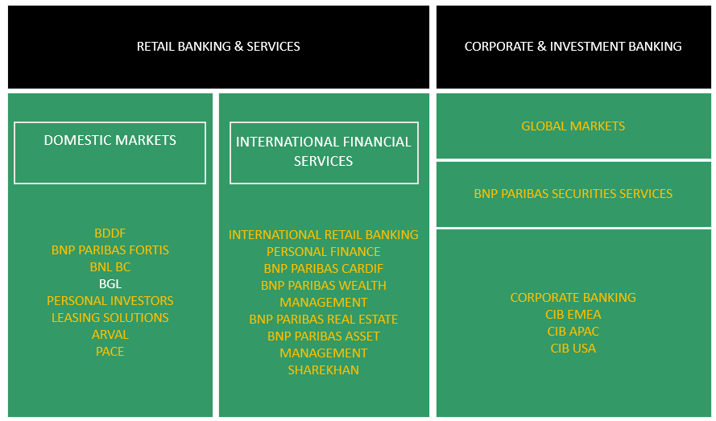
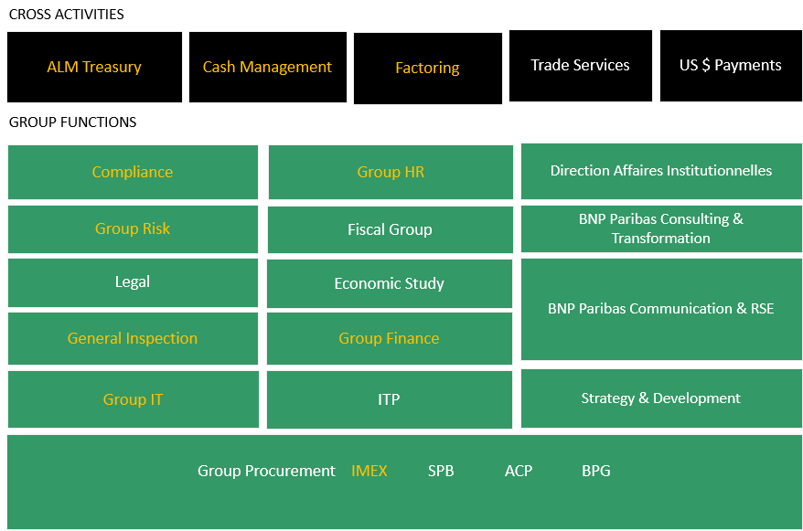
Tableau presence at BNP Paribas

Slide 5
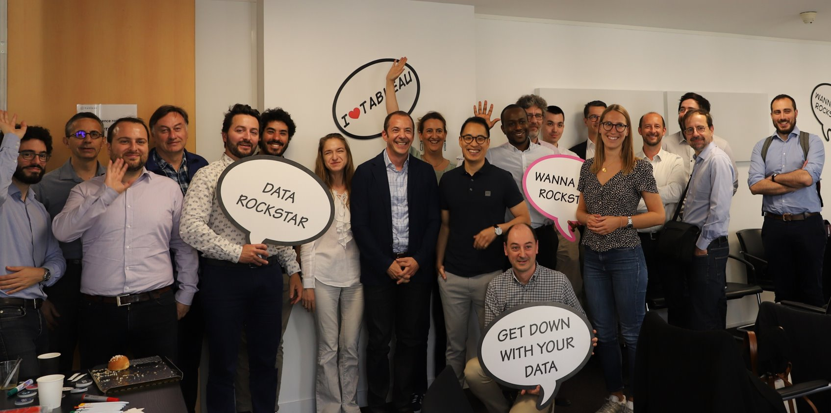
Tableau Community at BNP Paribas
Tableau User Group (TUG)
What is it?
Mission
June 21st Edition
Our ambition
Dynamize the community
Increase frequency : 2 times a year
Animate main key topics
Training & tutorial best practices
Governance
Tableau Ecosystem
On boarding and adoption of new users
Guidelines Design
And also Animating TUG and Usecase white Paper
Notes:
Tableau User Group user group is a form of technical and functional assistance. The idea is to share ongoing product innovations on Tableau in order to share experiences, develop and maintain a topic
Tableau User Group mission :
Maintain and share information about Tableau in order to fulfil the needs of business entities and functions
Consolidate elements to enhance best practices between business entities/ functions
We launched at TUG first edition June 21st with 15 stream leaders (almost all in this room today.) we have gathered this community of Tableau leaders to help users find answers, get inspired, and make connections
We brainstormed together and selected key topics:
Training / Tutorial Best Practices: Pierre Axel Thebault
Governance: TBD
Tableau EcoSystem: Erick Duponchel
OnBoarding – Adoption of new users: René Penvern
Guidelines Design : TBD
Animating TUG :
Usecase white Paper
Frequency – 2 times / y in FR + EN.
Our ambition for the near future:
Create other TUG Editions and increase the community !
Pierre-Axel to ask Mokrane: “On your side, Mokrane can you please tell us what’s new?”

Slide 6
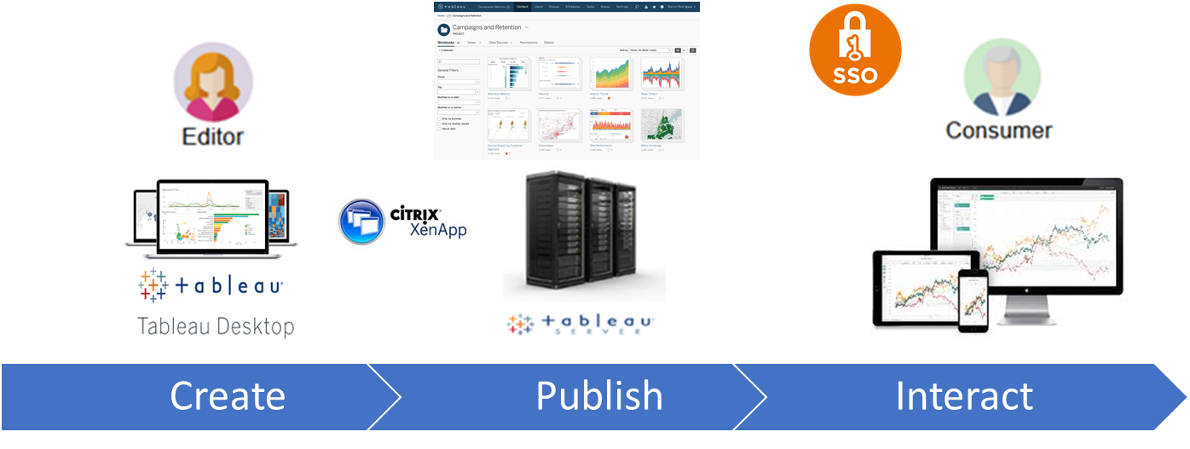
Tableau offering at IT Group
Our Offering
Tableau Server :
a standard for “Power Self-Dashboarding” gathering the best of both world business and IT.
a scalable platform for a simpler onboarding in a secured and governed way
Data Factory at ITG IPS
Adapt to the Modern Data Landscape (Big Data , Faster delivery, …)
Organized in Streams
Cover each main Data Use Cases
Roadmap fed by selected Stakeholders requirements
Agile Organization
Project onboarding :
Mainly French Retail Banking / Risk / HR Group
IT Project instruction to allow Business / IT / Production collaboration
Notes:
Our Offering as IT Group IPS: Tableau is referenced as a self-service dashboarding and governed visuals analytics gathering the best of both world business and IT.
Data Factory IPS :
Tableau not Shadow IT
streams leaders :Present the product owner at IT group XXXXX
The rules we have put in place to onboard new users are : XXXX ; agile backlog
We have onboarded several projects with hundreds of new business users like :
Domestic Market: Client Cockpit (DATAC & KYC) > Eric Pavie will present his usecase in a few minutes
Financial results for Comex DM,
Smart Monitoring for Senior Credit Officer at Risk,
Géo-Marketing analysis (D3C)
Cash Management, French Private Banking
HR Data
Pierre – Axel to ask Mokrane: “That’s great, so what is next?”

Slide 7
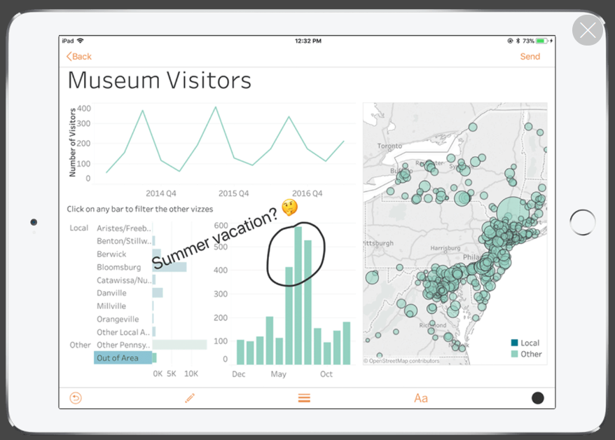
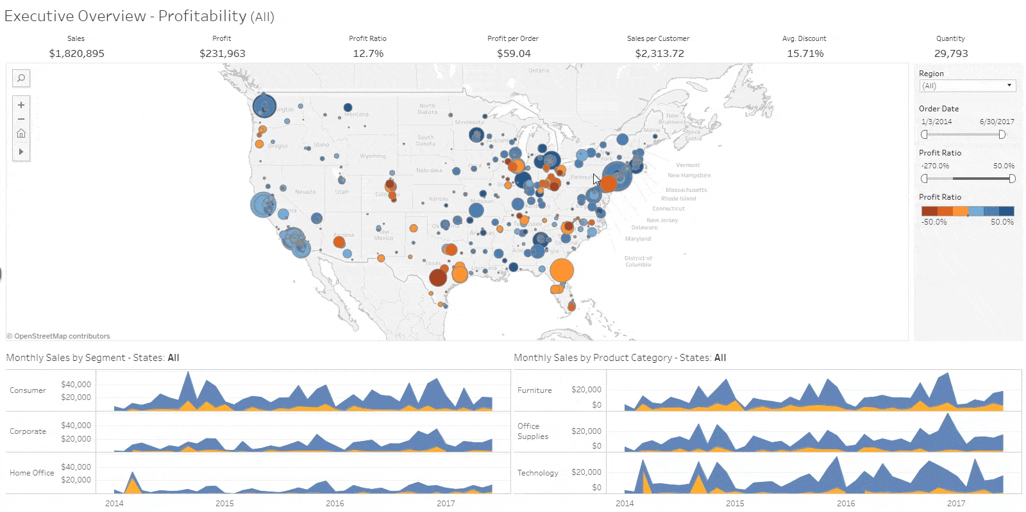
Tableau offering at IT Group
Current:
5,000 users on the platform
Target: 14,000 users at the end of 2020.
Version of Tableau Server deployed: 10.4.1
Onward:
Upgrade to 2019.2 in November
Switch to 64b
New features : Web authoring, Viz in Tool Tips, Ask Data, Mobile enhancements, Hyper, WDC, …
Let us know what is your “best to have” !
One new version per year
New cloud deployment model ?
Notes:
We have now 5,000 users on the platform with a large part by BDDF ; 14,000 users end of FY2020
Our current version of Tableau Server deployed is a 10.4
We plan to upgrade in 2019.2 in November
It will bring additional value for users with Viz in Tool Tips for example or Ask Data!
Stay Tuned, upcoming features will presented by Chrystelle & Charlotte, just after our introduction
Our ambition is to release one new version of Tableau per year.
Mokrane to ask Pierre-Axel: “ So, as business you can do whatever you want ?”

Slide 8
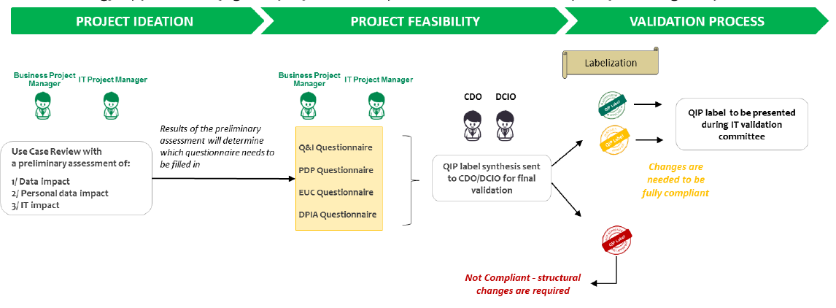
Governed Data & Self Service
A joint venture between CDO & DCIO

