Slide 1
Example Champion Programs
Examples from real Tableau customers (anonymized) outlining their Data Champions program
Notes:
Title Slide

Slide 2
Example #1
Company Industry: Telecommunications
Number of Employees: 200,000
Headquarters: United States
Example #1

Slide 3
for organizations
Program goal:
Create a “Champions Council” to increase efficiency in Tableau utilization and help drive to become a data-driven organization
Enablement of efficiency and best practices at scale
Create standardization for training and getting started resources
Example #1

Slide 4
Champion role:
Create a consistent Tableau culture within the organization
Review and enable a Skill Belts program
Present a single, unified front to IT fro Tableau requests
Share best practices and experiences with Data Doctor, User groups and analytics summits
for champions
Champion benefits:
Networking and leadership opportunities
Catalyst for change
Directly impact the data culture within organization
Example #1

Slide 5
Example #1
Program Overview:
# of Champions | Length of program | Identification Process | Champion Prerequisites | Summary of engagement/training activities | Recognition
N/A | Ongoing | Appointed by leadership | Have received some benefit from visual analytics Know and understand the Tableau infrastructure at company Understand budgeting process and license allocation Have resource to help create a CoE | Quarterly champions meetings Monthly one-hour calls Sponsorship and judging Iron Viz Games and annual Tableau Day Distribution of newsletters and information to own team | N/A
Example #1

Slide 6
Example #2
Company Industry: Travel and Services Industry
Number of Employees: 5,000
Tableau Deployment:
2,420 Online Users
140 Creators, 750 Explorers, 1,500 Viewers
Headquarters: Mallorca, Spain
Example #2

Slide 7
for organizations
Program goal:
Empower teams with Tableau as a fast and easy data discovery tool
Reduce dependency on central teams for daily job activities
Improve the data understanding in frontline teams
Improve effectiveness and efficiency on data monitoring and reporting needs
Example #2

Slide 8
for champions
Champion role:
Be Internal points of reference and an extension of the COE
Community representatives by being a voice and sharing feedback from all Tableau users
Trusted advisor to the BI team by providing feedback and helping the BI team to improve service and agility
Champion benefits:
Collaborate and work with other Champions/Tableau experts
Exposure to extra BI product information & roadmaps
Company-wide recognition as a Tableau expert
Positively impact other users and organizations’ objectives
Example #2

Slide 9
Example #1
Program Overview:
# of Champions | Length of program | Identification Process | Champion Prerequisites | Summary of engagement/training activities | Recognition
55 | 3 months | Held Tableau wide meeting introducing the program Attendees respond to survey if they’re interested in being a Champion List reviewed by management and selections made | Passionate for data and analytics measured by Tableau activity Interest and willing to learn Willing to help others Networking and capacity to influence others | Monthly champion meetings (30 minutes) 3 month training program Monthly best practice webinar Forum participation Dedicated Data Doctor sessions Weekly blog that champions contribute to | Dashboard of the month Company wide recognition Community representative
Example #2

Slide 10
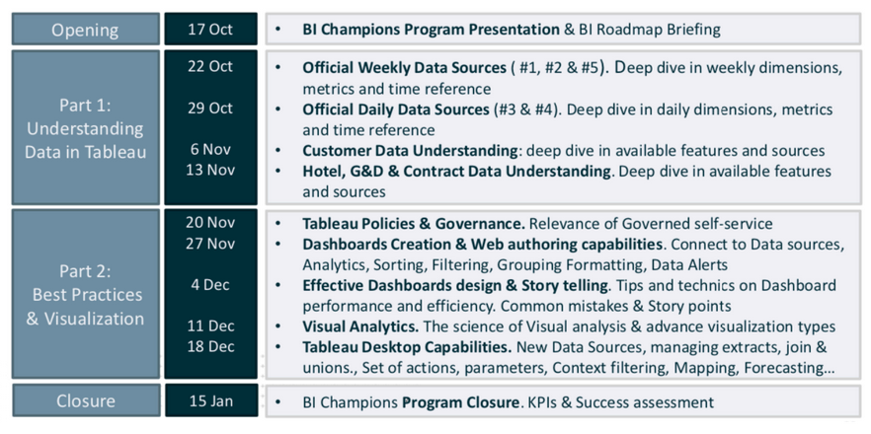
Training program
Example #2

Slide 11
Example #3
Company Industry: Communications
Number of Employees: 83,163
Headquarters: Paris
Example #3

Slide 12
for organizations
Program goal:
Faster onboarding and upskills of new users
Reduce dependency on central teams
Improve effectiveness and efficiency on data monitoring and reporting needs
Reach local organization/teams by giving them tools to use and analyze data while offering autonomy and support
Example #3

Slide 13
Champion role:
Advocate – inform others about changes and updates regarding Tableau and help adopt new processes
Support – Help with adoption, identify use cases and participate in standardization strategy of report
Help – help other users, share feedback to central BI team and request or organize Tableau events
for champions
Champion benefits:
Learning and growth
Special training and certification opportunities
Networking and relationship building with BI teams
Example #3

Slide 14
Example #2
Program Overview:
# of Champions | Length of program | Identification Process | Champion Prerequisites | Summary of engagement/training activities | Recognition
No set number | Ongoing | Support from manager Application via Forms 1 hour motivation interview | Self-starter Manager’s approval | Participate in the standardization strategy for Tableau reporting New user onboarding sessions Community activities Contribute to training content and documentation | Learning and growth opportunities Access to Tableau conference Learning Path/Certification Special relationships and exchange with BI teams
Questions ask on application:
Who are you?
What department are you in?
What is your specific role?
Would you be interested in helping The Tableau community at this company?
What is your current Tableau skillset?
What projects have you worked on with Tableau?
Example #3

Slide 15
Example #4
Company Industry: Tech
Number of Employees: 3,000
Tableau Deployment:
80 Creators
400 Viewers and Explorers
~700 dashboards
Headquarters: Indonesia
Example #4

Slide 16
for organizations
Program goal:
1. Create data ambassadors for users’ specific teams
2. Scale COE and become a data-driven organization
3. Test and standardize best practice for Tableau training
Example #4

Slide 17
Champion role:
1. Data ambassadors for their team
2. Mentors for other teams
for champions
Champion benefits:
1. Training opportunities
2. Mentoring
Example #4

Slide 18
Example #4
Program Overview:
# of Champions | Length of program | Identification Process | Champion Prerequisites | Summary of engagement/training activities | Recognition
43 out of 195 applicants | 3 months | Application process | From a variety of departments and teams Business users (not in the BI team) | 4 Week long training program Followed by 3 weeks of mentoring Showcase at the end of program | Showcase at end of program
4 week training curriculum:
SQL 101
Understanding Data at our company
Intro to Data Analytics
BI Sharing Session
Big Query
Tableau
Example #4

Slide 19
Example #5
Company Industry: Public Sector
Company Size: 7,500
Example #5

Slide 20
for organizations
Program goal:
1. Create a group of departmental liaisons for all things related to Tableau.
2. Expand ITs ability to support their growth analytics capabilities within the organization
3. Help scale Its infinitives such as data sharing, web authoring and design best practices.
Example #5

Slide 21
Champion role:
Act as an data ambassador within their team
Act as a liaison back to IT to provide updates on questions, data issues, training resources
Scale ITs role and provide mentoring, best practices and getting started resources to all users
for champions
Champion benefits:
Additional training opportunities
Opportunities to work with others outside their own team
Help IT develop best practices and training for all users
Example #5

Slide 22
Example #1
Program Overview:
# of Champions | Length of program | Identification Process | Champion Prerequisites | Summary of engagement/training activities | Recognition
N/A | Ongoing | N/A | Analyst or Manager Ability to attend regular trainings Willingness to support local and internal Tableau User Group Communicate updates to their department and IT liaison on a regular basis | Training on: Customer Portal Desktop vs. web authoring models Identifying shared data for web authoring and publishing | N/A
Example #5

