Slide 1
Data Champion Education and Training Resources
Notes:
Title Slide

Slide 2
Content
Incorporating training curriculum into your Data Champions program is a great way to incentivize employees to join, up level their skills and equip users with the knowledge they need to educate and help others. The following slides provide examples of how you can leverage existing Tableau programs and resources to create your own training program.
Role- Based Learning Paths (eLearning) – Curated curriculum based on a user’s role within an organization. At the end of the course, users take an assessment to earn a role badge that they can share on social media and throughout their organization. Learn more.
Education Plan template + customer example – Example of potential structured education plan, specific to different roles with a combination of curriculum for various Tableau programs
Training Plan Dashboard – A dashboard on Tableau Public that can provide you with ideas on how to structure your plan
Tableau Product Certification – A list of Tableau certifications that will enable users to prove their expertise and to distinguish themselves.
Learning Resources – A summary of all the free and paid training resources Tableau offers

Slide 3
Learning Paths

Slide 4
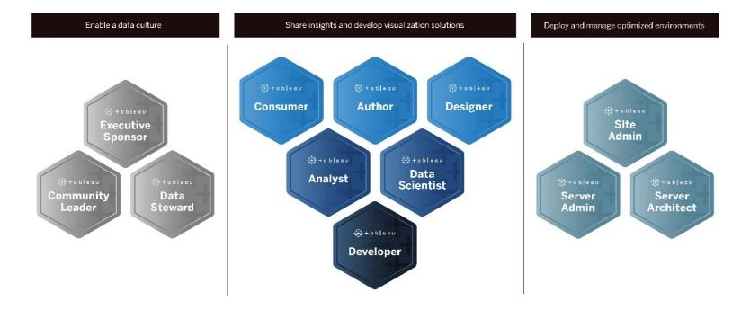
What are Role-Based Learning Paths?
Take this short quiz to find out which learning path is right for you!
Notes:
As a company, we are pivoting away from product-oriented education and towards a role-based focus to more rapidly address the needs of our customers to help people and organizations onboard quickly, to boost Tableau productivity and help users gain deep confidence in their analytics skills
With Role-Based Learning Paths, Tableau organizes interactive-virtual course content designed for common data roles within an organization (and aligned to Blueprint) so that customers can get more value out of Tableau quickly and on the fly. In this slide, you will see there are three uniquely grouped Learning Path categories. We’ll go into more detail about each of these categories next, but just know that once you’ve found the right learning path, you can take eLearning for a test run or buy a subscription to access it in full at any time.

Slide 5
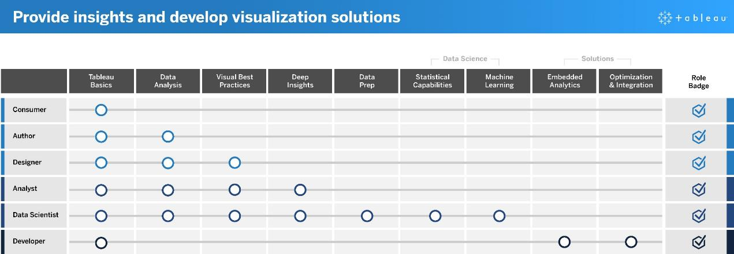
Review what each Learning Path offers
Notes:
We have roughly grouped Role-Based Learning Paths into three (3) categories.
Category 1: Provide Insights and develop visualization solutions
These roles use the capabilities of the Tableau platform to consume and create business solutions that range from ad-hoc visualizations to embedded analytics. Think Content Creators and Consumers.
Category 2: Enable a Data Culture in your organization
These roles establish cultural and technical standards to align every Tableau user to the analytics goals of your organization. Think roles like principal stakeholders, champions and domain experts. Think Principal Stakeholders, Champions and Domain Experts.
Category 3: Deploy and Manage an Optimized environment
These roles plan scalable deployments of Tableau Server or Tableau Online and once in production, ensure that users can access what they need when they need it. Think key roles like a BI Manager or IT staff who oversee your Tableau deployment.

Slide 6
How can you use Learning Paths?
Provide eLearning licenses to all Champions and require them to earn X number of badges throughout the duration of the program
They can add badges to their email signatures, LinkedIn profile, Data Champion directory, etc.
Require a Learning Path badge as a prerequisite to being a Champion

Slide 7
Education Plan Template & Customer Example

Slide 8
Education Plan Template
The below plan is an idea of how you can structure a training/education program over time with various Tableau education resources.
0-6 Months
Getting Started
6-12 Months
More Advanced
All Champions (role agnostic)
Free Training Videos
On-Demand Webinars
Learning Paths Badge
Champion Explorer
eLearning for Explorer
Desktop I
Basics
Visual Analytics
Desktop II
Intermediate
Certification Desktop Specialist
Certification Qualified Associate
Champion Creator
eLearning for Creators
Desktop I
Basics
Desktop II
Intermediate
Tableau Prep
Basics
Certified Professional
Visual Analytics
Desktop III
Advanced

Slide 9
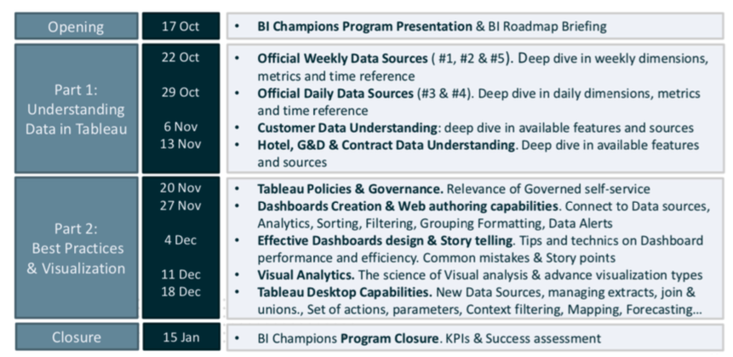
Customer example
Below is an example of the training plan a customer created for their program. They created their own content/topics and required Champions to go through this training during the first three months of the program.

Slide 10
Training Plan Dashboard

Slide 11
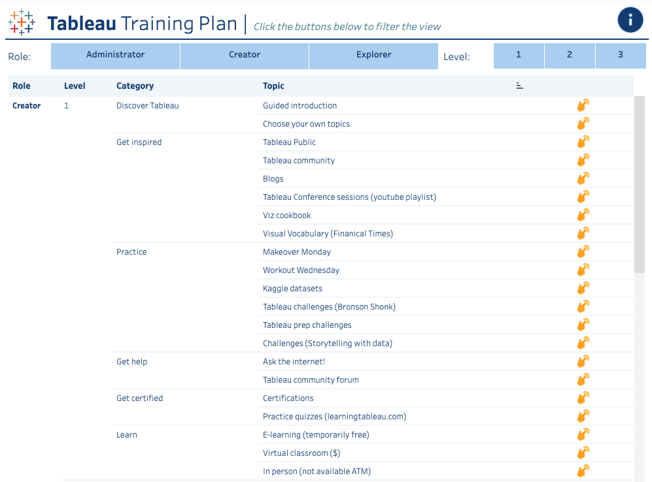
Training Plan Dashboard – On Tableau Public
This is a great dashboard to explore to gather ideas on how to structure a training plan. Filter based on role and level, follow the proposed sequence and/or pick and choose your own route.
Click HERE to access it

Slide 12
Product Certifications

Slide 13
Training Certification
Tableau Product Certifications are higher stakes than role badge skills assessments because they follow industry standards for professional certification programs. Encouraging and supporting certification within your teams shows commitment to their professional development and creates clear, actionable milestones for individuals to work towards. By building a core group of certified users, you increase their confidence and encourage them to elevate the skill sets of their peers.
 | Exam Level | By Product
Increasing difficulty | Specialist | Tableau Desktop Specialist – tests foundational functionality and product comprehension.
 | Associate | Tableau Desktop Certified Associate – tests comprehensive functionality and product expertise. | Tableau Server Certified Associate – tests administrative functionality and platform knowledge.
 | Professional | Tableau Desktop Certified Professional – tests advanced functionality and application of visual best practices. | Tableau Server Certified Professional – tests architectural knowledge and platform integration expertise.

Slide 14
Summary of Training Resources

Slide 15
Summary of resources
Free training resources | Paid Training resources | Social/community learning
Tableau Starter Kits Practice authoring, interacting, publishing and administering Tableau Check out the Getting Started pages for more great resources | E-Learning Web based training with interactive courses curated to specific roles. | Tableau User Groups (TUGs) Local and virtual User Groups where you can connect and share with peers from different organizations.
Training videos You can download all of these and add to your own intranet here. | Learning Paths Self-paced, role specific curriculum with a skills assessment to earn badges. | Community Forums Find answers to questions and answer others’ questions as well.
Whitepapers Download and add to your own intranet | In-person classroom training In person formal training for various skill levels. | Tableau Public Explore thousands of visualizations, downloads the ones you like, and reverse engineer them!
Live online training webinars Free, one hour sessions on a variety of topics | Live virtual classroom training Same as in-person classroom training but offered in a virtual environment
On-demand webinars On demand webinars with downloadable workbooks

Slide 16
Notes:
Tableau Logo

