Slide 1
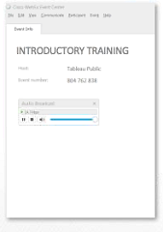
Election 2016:
Finding and Cleaning Data
Jade Le Van
jlevan@tableau.com
@jadalytics
Audio Broadcast will start when you join
You should be connected automatically to audio and see the ‘Audio Broadcast’ menu. Sound should stream once the webinar starts.
Note that you’ll hear silence until the presenter starts talking.
You will be put on mute automatically when you join the meeting.
Notes:
Title Slide

Slide 2
The process: from idea to viz
Search for data
Clean and prepare data set
(Visually) analyze data
Create charts for publication
Save to public.tableau.com, and share or embed in webpage
In Tableau Desktop
(Public Edition)

Slide 3
Agenda
Finding Data
Let the data come to you
Data Portals
Scraping
Tableau Public
Cleaning and Preparing Data
In Tableau (Data interpreter, Pivot)
Other free tools if data cannot be cleaned directly in Tableau
Notes:
Table of Contents

Slide 4
Finding Data – All the resources
1. Let the data come to you
Data is Plural newsletter
If This Then That (IFTTT)
3. Scraping
Google Sheets import functions
Import.io
2. Data Portals
Ballotpedia
Enigma
4. Tableau Public
Download workbook & get data (example)
Twitter Web Data Connector
List of Web Data Connectors

Slide 5
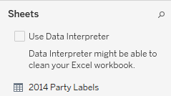
Cleaning Data – All the resources
In Tableau Public
Data Interpreter
Pivots
More data prep in Tableau tips in this blog post containing a video tutorial
2. Other Free Tools introduced in this blog post
Data Wrangler, easy to use online app for data cleaning
Open Refine (download) Read this tutorial for a quick start

Slide 6
Notes:
Tableau Logo

