Slide 1
Conociendo Tableau
Alberto Garcia
Lead Solution Engineer
Notes:
Good morning / afternoon
This session is called “Get to Know Tableau” – it’s designed for people who are brand new to Tableau and want an overview of what we’re all about.
My name is Chris Beck. I’m a solutions engineer.
Before joining Tableau, I was a customer of Tableau just like you. I was a reporting and analytics administrator helping individuals, in the organizations I supported, to identify opportunities in their business.

Slide 2
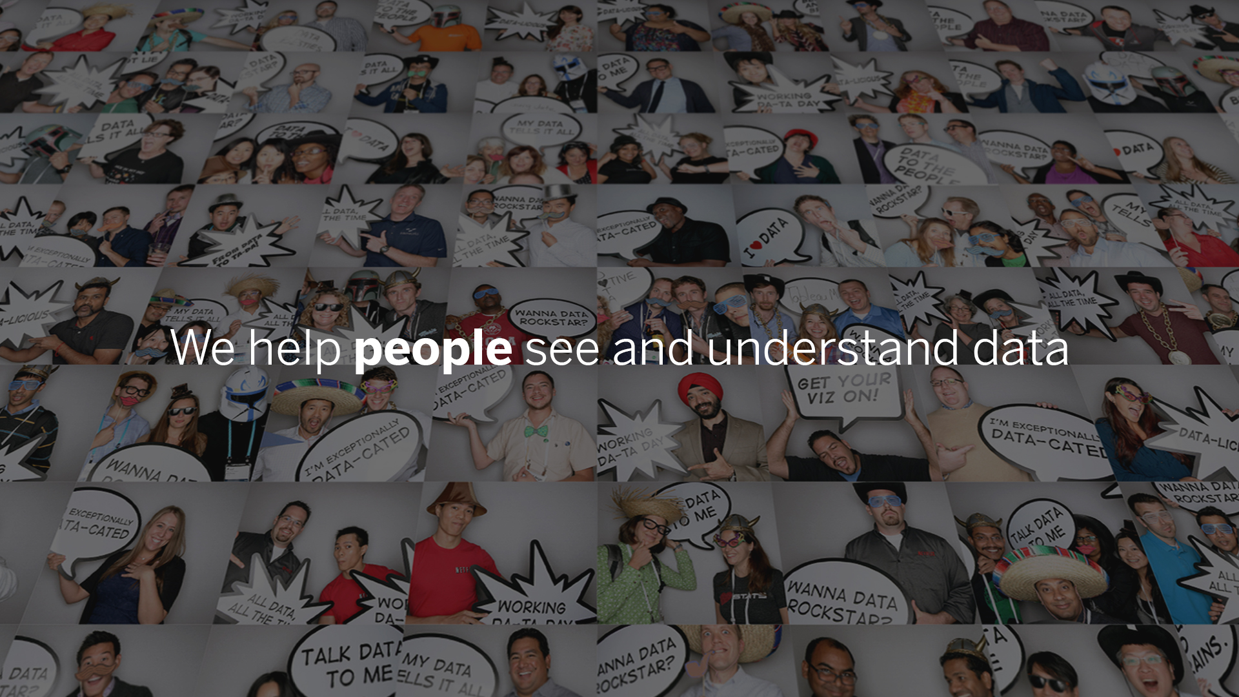
Notes:
I joined Tableau because the help people see and understand data.
At Tableau, we believe that putting analysis in the hands of everyday users is one of the most important opportunities and greatest shifts in computing this century.

Slide 3











Analiticos para cualquier usuario, con cualquier dato, en donde sea
Expandiendo capacidades con
Cualquier usuario
Cualquier dato
En donde sea
Analista
Conectar
In-app
Embedded
Combinar
Usuario Final
On-prem
Catalogo
Ejecutivo
Cloud
Notes:
Tableau is agnostic to data. We don’t care where it comes from, where you want to consume, or who wants to consume it. The Tableau Platform was built since day one with one goal in mind. Get data into the hands of the people.

Slide 4
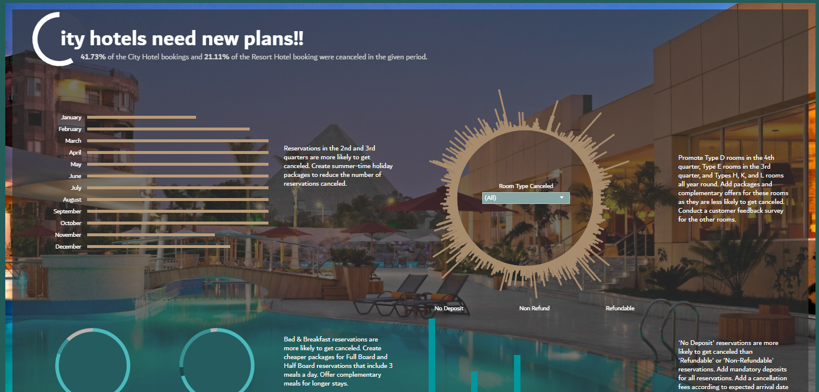
Notes:
Whether you want to understand hotel bookings in the Hospitality industry

Slide 5
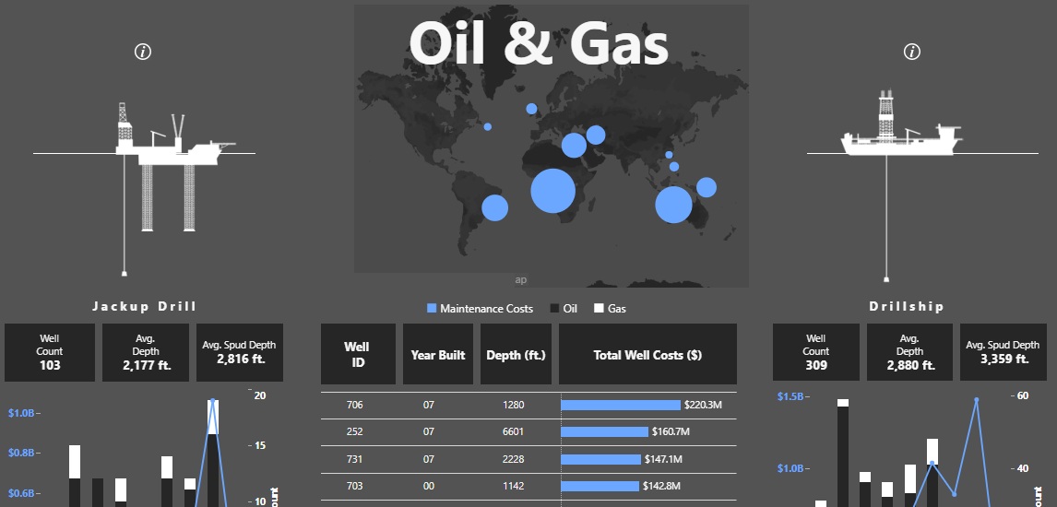
Notes:
Or analyze an oil rig in the Energy and utilities sector

Slide 6
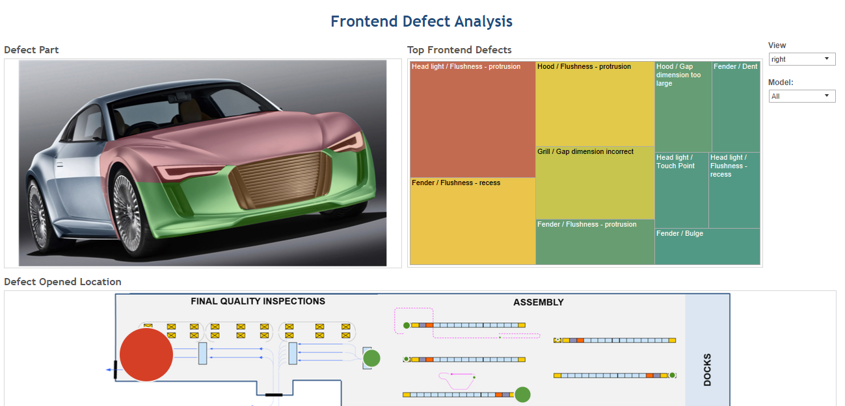
Notes:
You can easily understand defects in a manufacturing plant to decrease repairs and identify areas of focus for increased training

Slide 7
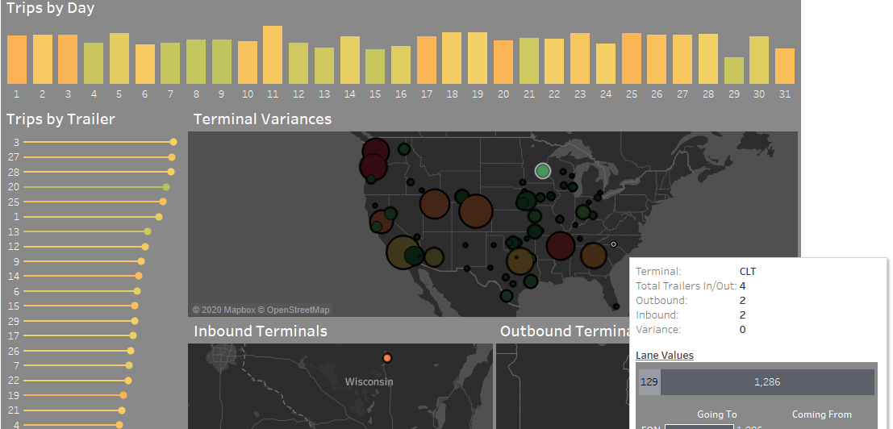
Notes:
Or maybe you want to optimize shipping lanes for inbound and outbound freight

Slide 8
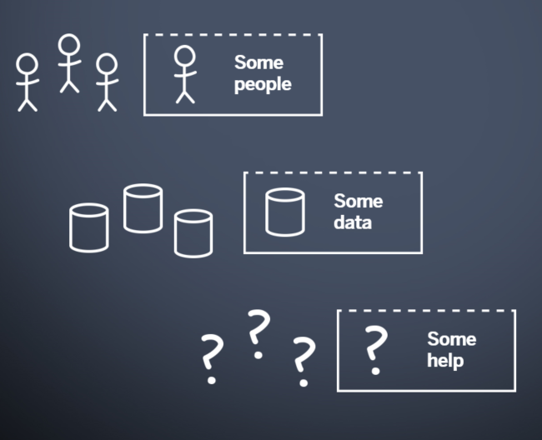
Cosas que escuchar…
Centralizado / Modelo de BI Fabrica de Reportes
“Nuestros empleados extraen datos en hojas de calculos para analisis”
“No contamos con acceso directo a nuestros datos”
“A nuestra compañia le toma mucho tiempo construir reportes”
“La mayoria de las veces no temenos visibilidad de que dato se esta usando y quien lo esta usando”
“Enviar nuestros reportes de vuelta a TI para poder responder preguntas de negocio adicionales puede llevarnos semanas”
Notes:
Do any of these things sound familiar to you? Let me tell you a quick story about Pete and Norm.

Slide 9








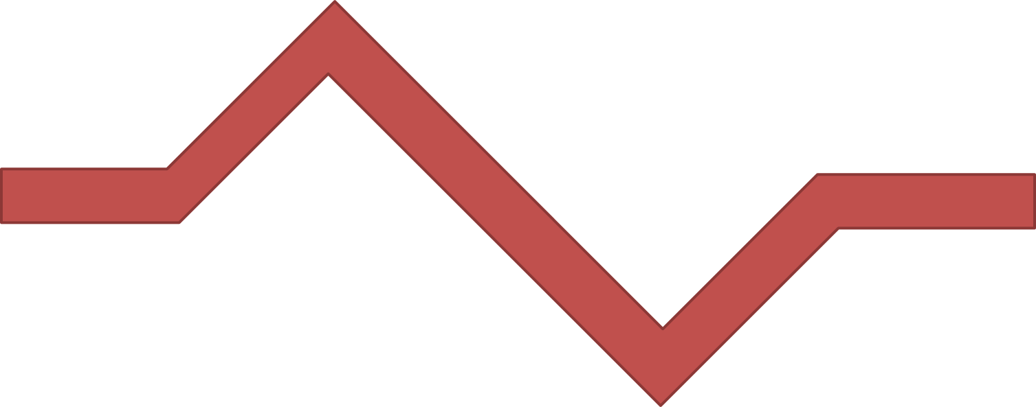













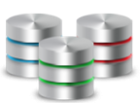
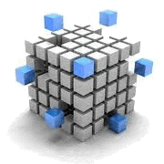











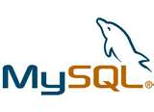




Analyze
!?
Analyze
Plan
Plan
Design
Design
Peter - Analista
Susie - Gerente
Develop
Develop
Test
Test
Produce
Produce
Maintain
Maintain
Dashboards
Reportes
!?
Construye Metadatos
Capa Semantica
Norm – Architecto
Legacy Platform
Administra
Infraestructura
Monitorea
ETL
EDW
Data Marts
Cubos
Extracciòn – Transformaciòn - Carga
Fuentes de
Datos
Notes:
At the very foundation of your enterprise lies your raw data sources. You then have ETL processes in place that serve data up to your data marts, cubes, and data warehouses.
Then you have the Enterprise BI stack that includes a Semantic model and dashboards and reports that sit on top.
Then we have Norm, our BI Architect. He has access to the underlying data, monitors the ETL processes, manages the data infrastructure, and builds metadata to support the needs of the business. This is where he authors all the reports to answer questions the business has.
Then we have Peter, a business analyst that has question so he connects to a report Norm built to get his answer.
That report is really just serving as a proxy to the underlying data and security is either managed at the data source level or more likely, within the semantic layer.
But here lies the challenge, inevitably Peter is going to ask a question that isn’t answered by the reports he has access to. So to get at the data he needs, he files a support ticket. That ticket makes its way over to Norm, but Norm is a busy guy and Peter is not the only one with change requests so it gets put on top of the pile.
Let’s look at this queue for a moment, because as this fills up Peter is going to have to wait longer and longer to get his answer. Now what Peter doesn’t realize, is that what he thinks is a simple change request, is not so simple. Let’s say Peter is just asking for a couple fields to be added to the report. But those fields don’t exist in the report because they are not in the semantic layer, or the data mart, or the ETL job, because they come from a separate data source that was not previously included. Norm is forced to go through a time consuming waterfall process that requires changes in every layer of the BI stack. And remember this is just one request.
Eventually Norm does make his way through the queue, pushes out the enhancement, and Peter gets the answer he needs.
But then Peter has another question because the enhancement Norm made either didn’t quite answer the question he had or Peter saw something new and he wants to dive into it further. So the same process happens. Files a change request, which gets dumped into the que, Norm goes through h the change process, Peter waits, Norm pushes out the enhancement, and Peter gets his answer, or at least a partial answer.
We call this process the report factory, is this something you see in your organization?
And this process repeats itself over and over eventually leaving both Peter and Norm very frustrated.
So what’s really going on here that causes a line in the sand to be drawn between IT and the business? When Peter sends Norm a change request, he is really asking him to answer a question he has about the business. But Norm doesn’t have the full context about the question Peter is asking, because lets face he is not a mind reader, so he probably doesn’t fully answer what Peter was asking. But even if Norm did fully answer Peter’s question, Peter may see something new and have 3 or 4 more questions. The crux of the matter is that the legacy platforms were really built to help answer the known-unknowns. These are the measures and metrics your organization already knows that they need to monitor to assess the health and performance of the company. These are things like the quarterly booking, billing, and backlog reports. However, what Peter is really interested in is the unknown-unknowns. These are the questions that haven't yet been asked or are metrics that haven’t been looked at. The one off, ad-hoc, unanticipated questions that are not answered in existing reports. As we have seen, the challenge is the legacy platforms aren’t agile enough to get Peter the answers he needs in the time he needs them.
Is this reflective of where the relationship is between IT and business for you?
So what inevitably happens? The system cracks– either literally or figuratively. Peter needs answers so he goes rouge.
He downloads the data he has access to into csv’s and then, out of the ether emerges shadow IT. Shadow IT figures out a way to get access to the data, pulls that data into a SQL server they probably have running on a stolen desktop under someone’s desk, which allows Peter to pull out the data he needs.
But when Peter does this, any trace of security disappears and Peter spends countless hours having to curate all this data into his spreadmart. And this becomes a primary source of information that the Peter’s team used to make decisions.
What’s scary, is that Peter is not alone. There is a whole Army of Peters out their that are running the business on these self curated Spreadmarts
Most would agree that running the business off spread marts is not ideal for a couple reasons. Once the data is pulled into Excel, any investment into security is lost. We start to see multiple versions of the truth emerge because the Peter’s of the world pull in their data a bit differently. And maintaining these spread marts comes at a huge cost to Peter’s time.
Out of curiosity, how well does this describe your current environment?

Slide 10



¿Porque Tableau es Diferente?
Susie
Gerente
Chris
Analista
Preguntar
Responder
Norm
Architecto
Kelly
Ejecutiva
Peter
Analista
Notes:
So the question now is, how does Tableau fit in and how are we different.
At Tableau, we believe that everyone should be able to see and understand their data which means that anyone can both ask and answer their own questions. From a business perspective this makes a lot of sense the business really the ones best equipped to answer their own questions rather than trying to have Norm read their minds. Often, this why Peter goes rogue because he just wants to get an answer. But from an IT perspective, it raises the question of how do you enable the business in a secure and governed way. We cant just open the kimono and let the business roll around naked in their data. So lets go through a day in the life with Tableau and see how we can enable the business without losing ?

Slide 11

Las personas que hacen las preguntas
deberian ser quienes puedan responderlas
Notes:
Another of our core principles.

Slide 12

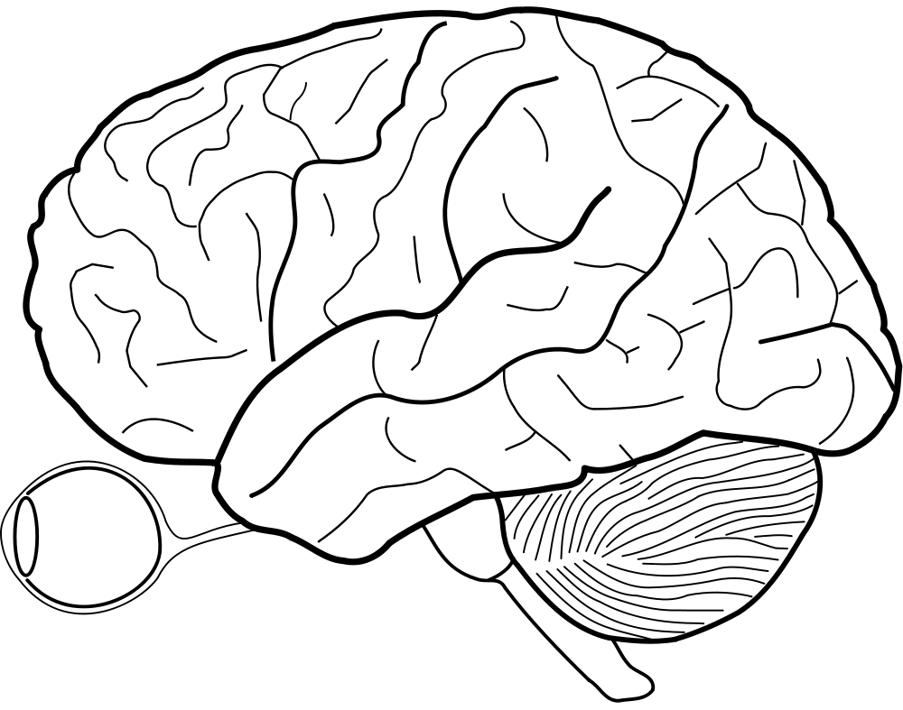
El pensamiento es LENTO. La vista es RAPIDA.
70%
de nuestros receptores sensoriales se localizan en los ojos
50%
del cerebro esta involucrado en el procesamiento visual
1/10th
de segundo es todo lo que se necesita para captar una escena visual
Notes:
So how do you go about putting people in the center of asking and answering questions?
You need to use what they’re good at.
We experience the world primarily visually; Chris Stolte and Pat Hanrahan realized that if they could put data into a form our visual system can make sense of, we can harness that power.
Our brains are wired to pre-attentively notice things that are presented in front of us. People process numbers slowly and inefficiently.
We see almost instantaneously and we detect patterns immediately.
------
References for the three facts
Merieb, E. N. & Hoehn, K. (2007). Human Anatomy & Physiology 7th Edition, Pearson International Edition.
Merieb, E. N. & Hoehn, K. (2007). Human Anatomy & Physiology 7th Edition, Pearson International Edition.
Semetko, H. & Scammell, M. (2012). The SAGE Handbook of Political Communication, SAGE Publications.
- See more at: http://neomam.com/interactive/13reasons/#sthash.XHhH17V1.dpuf

Slide 13
Longuitud | Anchura | Orientacion | Tamaño | Forma
Circundar | Posiciones 2D | Agrupar | Color (Resaltar) | Color (Intensidad)
Notes:
In fact, there are many patterns that our brains inherently recognize. Things like Length, width, size, shape, orientation.
Attributes that our brains can process without thinking about them. Think about how powerful that is.
Now imagine applying all that human power and potential, to data visualization.

Slide 14
Analiticos a Escala
Notes:
And for an organization to benefit from this, they need the ability to deploy it at scale.

Slide 15
Plataforma de Tableau
Desktop
Browser
Mobile
Embedded
Colaboraciòn
Alertas | Subscripciones | Storytelling | Compartir | Discusiones
Analiticos
Visual | Ad-hoc | Avanzado | Spatial | Calculos | Estadisticas
Descubrir contenidos
Projectos | Recomendaciones | Versionamiento | Busqueda
Seguridad & Cumplimiento
Extender & APIs
Gobierno
Fuentas de datos centralizadas| Certificaciòn | Analisis de uso | Permisos
Preparaciòn de Datos
Combinar Datos| Query Federation | Preparacion visual | Modelado de datos
Acceso a Datos
En vivo | En memoria | Conectividad Hibrida
Despliegue
ON-PREMISES | CLOUD | HOSTED
WINDOWS | LINUX | MAC
MULTI-TENANT
Notes:
We’ve taken the invention that makes visual data exploration so easy in Tableau, and built an enterprise platform around it.
From Accessing your data, to cleaning and prepping your data, to data certifications and permissions…combined with Machine Learning that helps guide you to the right content for your analysis, Advanced Analytics to help you better understand the stories in your data and the mechanisms to collaborate and share your insights across your entire enterprise.
We surround that with everything you need to keep your analytics environment secure and to remain compliant, as well as the ability to automate your processes via APIs and to make your data actionable
Most importantly, we offer customers flexibility …deploy on-prem, in the cloud or leverage Tableau Online, our fully hosted SaaS solution. Deploy on Windows or Linux. Connect to your data live or extract it into memory. Consume your data in your own portal, Tableau’s portal or through a Mobile App. The choice is yours.

Slide 16
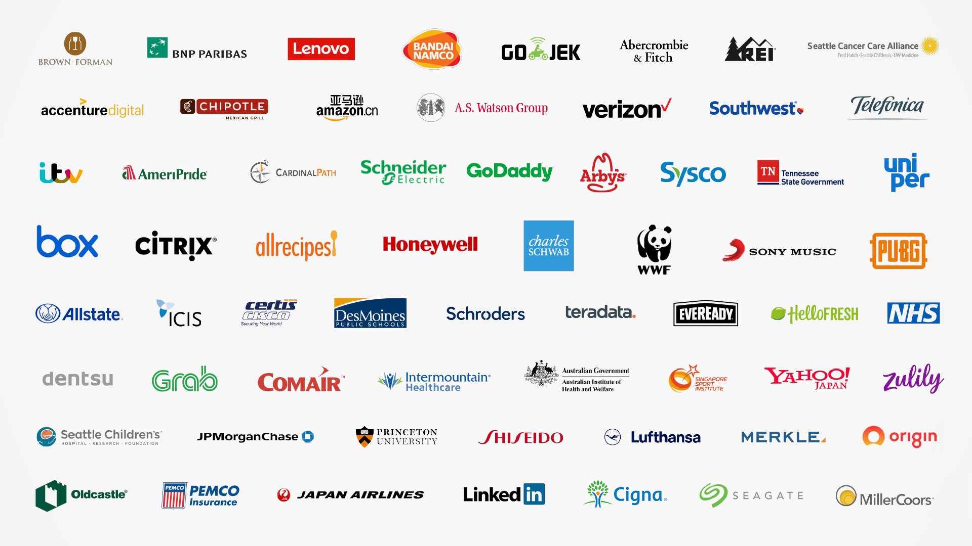
Decenas de miles de organizaciones dependen de Tableau
Notes:
There are tens of thousands of organizations that depend on Tableau.
Tableau has become a mission critical platform for Fortune 500 corporations, small and medium-sized businesses, government agencies, universities, research institutions, and non-profits.

Slide 17
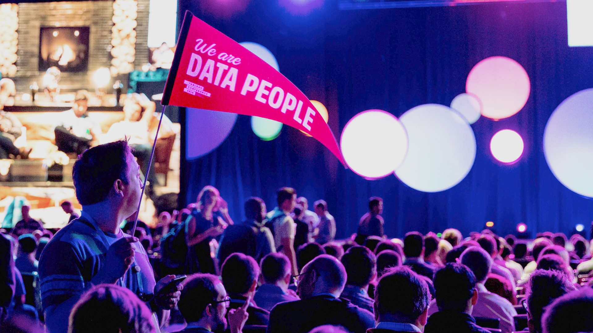
Notes:
But People don’t just use Tableau at work.
Our users are so passionate about Tableau, they take it home with them
The freedom to express themselves, the ability to bring their expertise to their area of the business first hand, the power to ask questions is liberating for people.
And they’ve shared their passion, with visualizations about -
Show people

Slide 18



Aprender
Inspirar
Conectar
Notes:
The reason our community is so active is because they help each other.
Show people

Slide 19
Tableau
Forums
Tableau
Public
Tableau User
Groups
Notes:
They use our forums to help each other out
They run over 500 user groups that are active all over the world
And they share their work on Tableau Public – the world’s largest repository of Data Viz.
Show people

Slide 20

>1 Millon de Estudiantes y Educadores
Tableau Academic
Notes:
And the success of Tableau has made it one of the most sought-after skills in the job market, and academia is taking note to help prepare the next generation of knowlege workers –
More than 1 million free licenses of Tableau have been activated by students, professors and lecturers.

Slide 21
Personas de Datos
Notes:
So where to now?
We started with Data People – and creating a new way to bring people and data together.

Slide 22
Notes:
As more people work with data it creates a network effect.
People find more value in data.
That’s because they find more analyses to consume, and as they access more data they want to do own analysis and share their findings with others.

Slide 23
Cultura de Datos
Notes:
That sharing contributes to the success of others. It helps builds the skills of others.
It builds trust between teams. And it ultimately starts to shift the mindset of the organization.
We call this Data Culture: where people start to help each other see and understand data.

Slide 24
Notes:
Which brings us right back to where we started.
I hope this was a helpful introduction to Tableau, and you feel like you know us a little better.
And I hope you have a better understanding of how we took a market that was dominated by a technology-centric approach.
And flipped it on it’s head with a focus on people.

Slide 25
Gracias
Descargar prueba gratis de 14 dias de of Tableau Desktop
Visita Tableau Public y subcribirse al 'Viz of the Day'
Notes:
Before we move into the live Q&A I have a couple of actions items for you to do straight after this webinar is over.
Firstly, make sure to download a free 14-day trial of Tableau Desktop directly from our website so you can quickly start analysing your own data.
Then, visit Tableau Public which is full of stunning visualisations that the Tableau Community has published for the world to see. Make sure to subscribe to 'viz of the day' to keep updated.

Slide 26
?’s

