Slide 1
Data Visualization and Discovery for Better Business Decisions
Mike Klaczynski
mklaczynski@tableausoftware.com
@mikeklacy

Slide 2
Tableau Software, Inc.
We make rapid-fire business intelligence software.
Fastest growing business intelligence company in the world
Stanford Professor Pat Hanrahan and Dr. Chris Stolte re-invented data visualization technology
Patented products are in use by 1,000’s of customers
Headquartered in Seattle, WA
Publicly traded as of May 2013
Customers:
eBay
Wells Fargo
Bank of America
Walmart
Safeway
GM
Pfizer
The Hartford
Microsoft
Merck
Ferrari
+ 10,000’s more

Slide 3
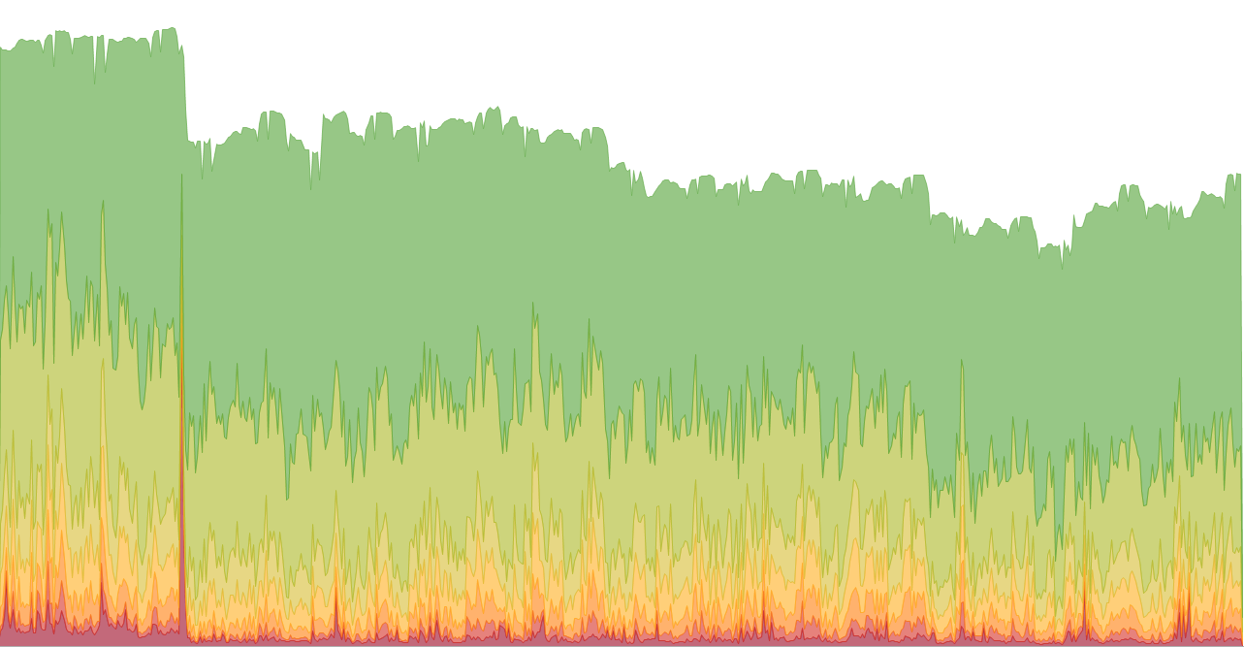
Help people
see and understand
their data

Slide 4
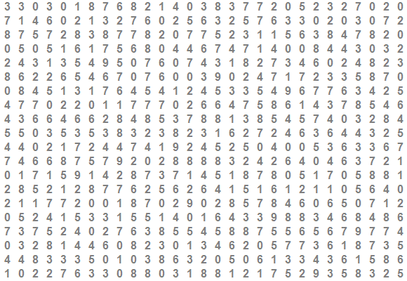

Slide 7
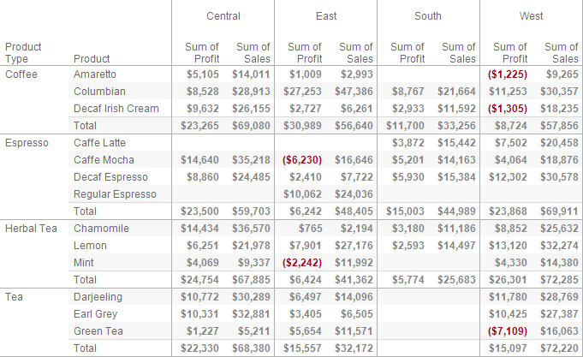

Slide 9
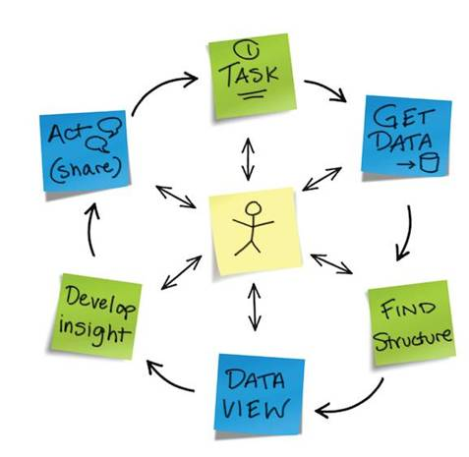
The Cycle of Visual Analysis

Slide 10
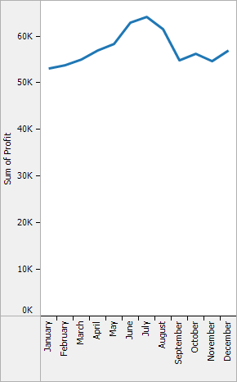
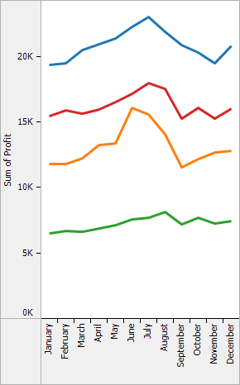
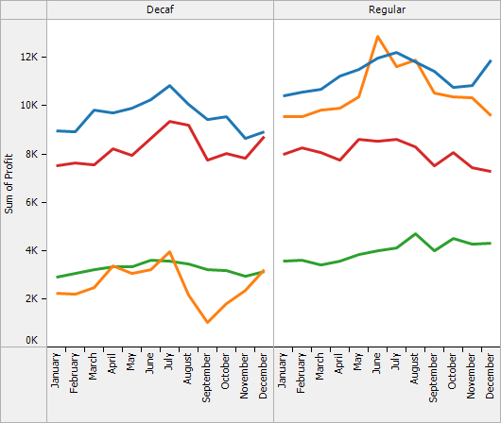
Supporting the Cycle
Incremental: allow people to easily and incrementally change the data and how they are looking at it
Expressive: there is no single view for all tasks and all data
Unified: leverage the revolutionary changes in database technology
Direct: make the tool disappear so the user can directly interact with the data
click
click

Slide 11
The Tableau Revolution
Fast and easy analytics for everyone

Slide 12
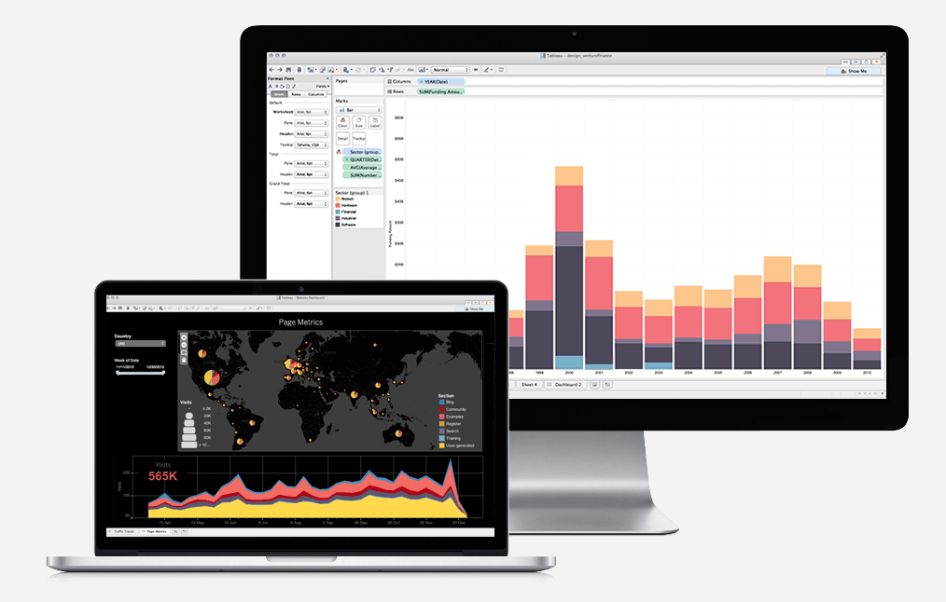
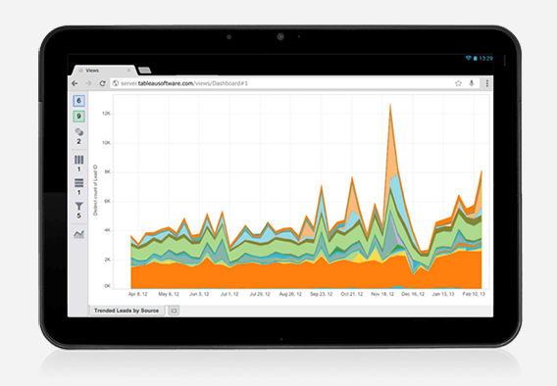
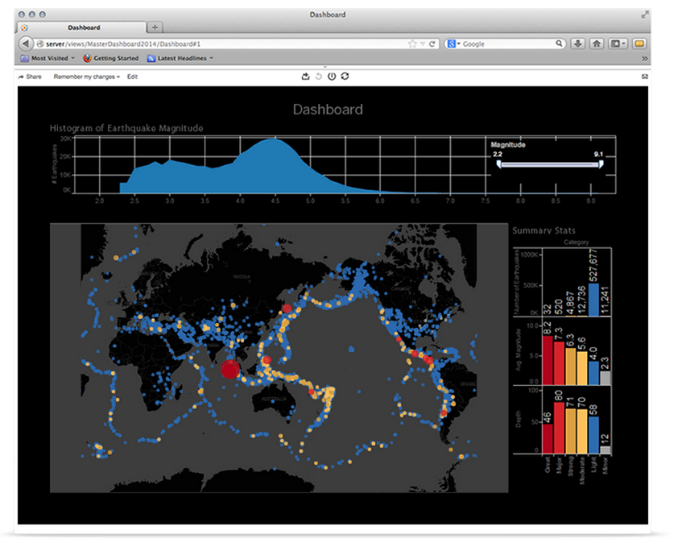
How Do People Work with Tableau?

Slide 13
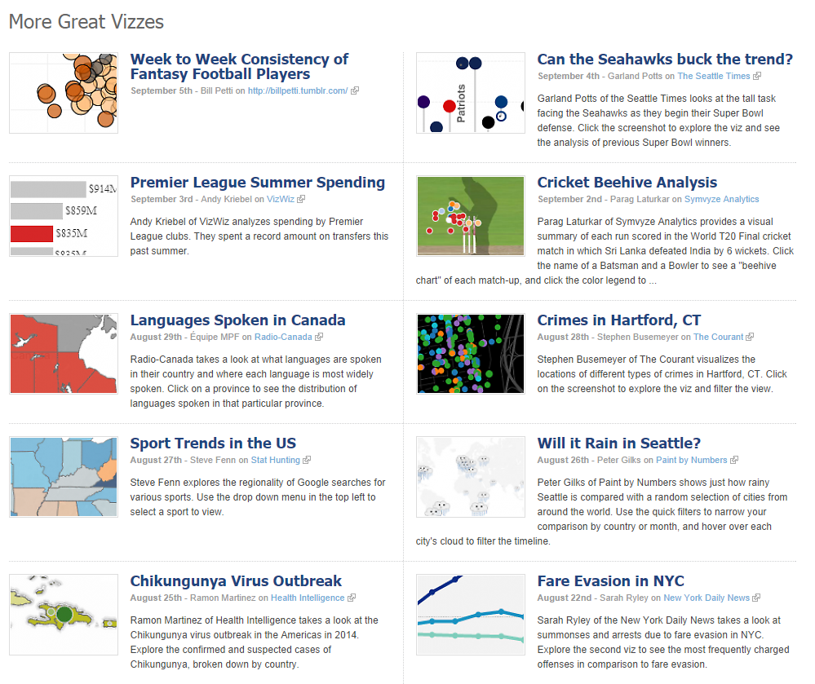

Slide 14
For Everyone
Ease of use leads to adoption across all departments and use cases

Slide 15
Let’s analyze some data!

